Slide 1
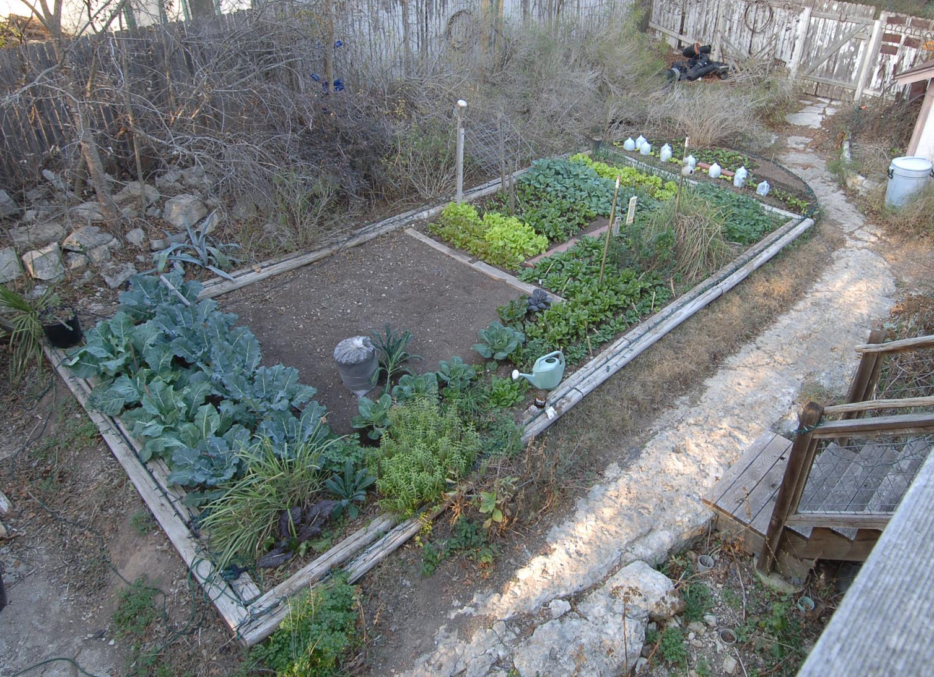

Slide 2
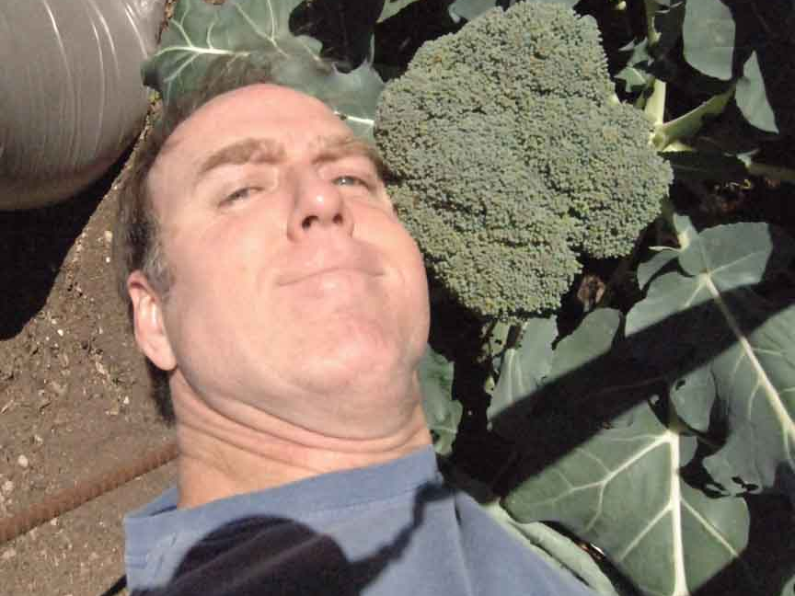

Slide 3
Outline
Introduction: Description of Presentation
Background: My story
A Short History of the understanding of Climate Change
The message from climate scientists: Good News Bad News
“The same voices that tell (simultaneously) that climate change is not real, it is a natural cycle, it is a grand scientific conspiracy, and it is good for civilization, also tell us that the solutions to controlling our CO2 pollution will ruin our economies.” Climate scientists are saying none of this.
Nearly 100 academic evaluations of the solutions to climate change tell us that they will cost about 1 percent of global GDP every year for 100 years. This is a phenomenal amount of money. But it is no more money that we have spent for the last 100 years building our human wastewater collection and treatment infrastructure. That’s right. The solutions to greenhouse gas pollution problem are no more expensive than the solutions to toilet waste pollution.

Slide 4

Short History of Climate Change 1
A Short History of
Climate Change
1824
Jean-Baptiste Fourier discovered the greenhouse effect through calculations that showed Earth would be far colder if it lacked an atmosphere.
1842
Joseph Adhemar first proposed Earth’s orbital cycles caused ice ages.
1859
John Tyndall discovers that some gases block infrared radiation. He suggests that changes in the concentration of the gases could bring climate change.
1896
Svante August Arrhenius publishes first calculation of global warming from human emissions of CO2.
1897
Thomas Crowder Chamberlin produces a model for global carbon exchange including feedbacks.

Slide 5
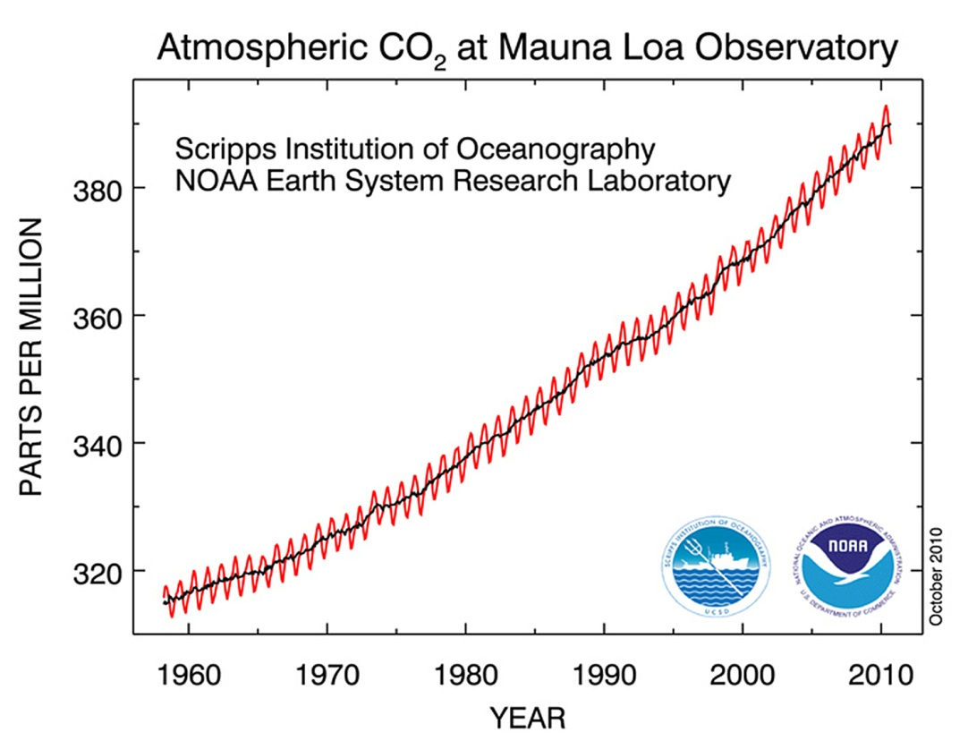
Short History of Climate Change 2
1938 – Milutin Milankovitch published formula for orbital changes as the cause of ice ages.
1938 - Guy Stuart Callendar argues that CO2 greenhouse global warming is underway after compiling temperature records beginning in the late 19th century.
1955 - Hans Suess discovered that radioactive carbon-14 in wood samples from atomic testing made accurate evaluation of atmospheric fossil fuel depleted C-14 possible.
1958 - Charles David Keeling began his CO2 monitoring on top of Mauna Loa in Hawaii.
1965 to 1979 - A search of the scholarly literature found 7 articles predicting cooling and 44 predicting warming.
1965 - President's Science Advisory Committee (Lyndon Johnson) found that by the year 2000 the increase in atmospheric CO2 may be sufficient to produce measurable and perhaps marked changes in climate.
The Keeling Curve: Atmospheric carbon dioxide concentration measured atop Mauna Loa in Hawaii. The wiggles are caused by the annual increase of carbon dioxide caused by organic matter decomposing in the northern hemisphere winter. (Vegetation is far more abundant in the northern hemisphere, which causes the annual fluctuations.)

Slide 6
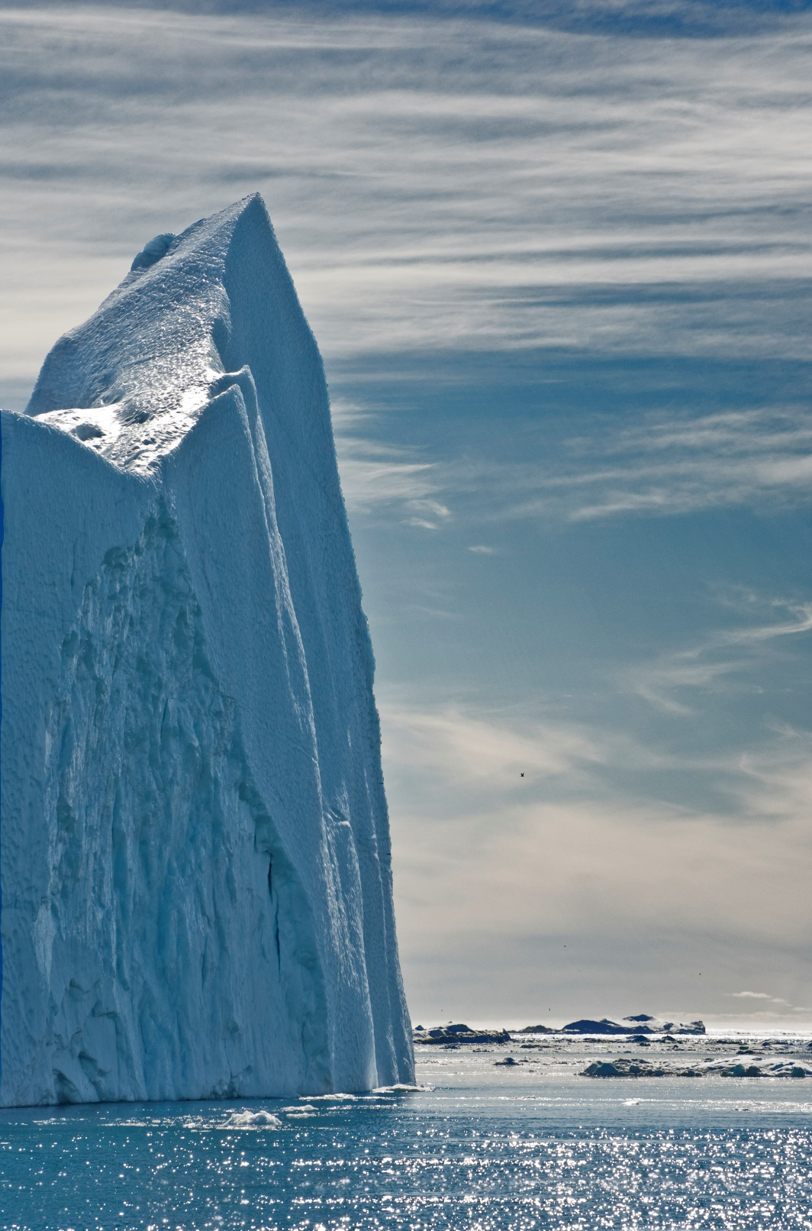
Short History of Climate Change 3
1974
Wallace Broeker’s work showed that air pollution from rapid industrialization after WWII created a pause in global warming and that new air pollution rules in the U.S. would allow global warming to return and warm Earth beyond anything experienced in the last 1,000 years by the turn of the 21st century.
1980 - Ice cores from Greenland began to show radical differences in CO2 concentrations in the last 100,000 years glacial cycle.
1981 - NASA’s Goddard Institute for Space Studies published its first global temperature analysis.
1981
Wigley and Jones found that greenhouse gas emissions need to be reduced far ahead of projected climate change due to thermal inertia of Earth.
1985 - The first ice core from Antarctica penetrated two miles deep and recovered 150,000 years of climate records frozen in time. Evidence in bubbles trapped in the ice “locked-in” theory about greenhouse gas concentrations and global warming.

Slide 7
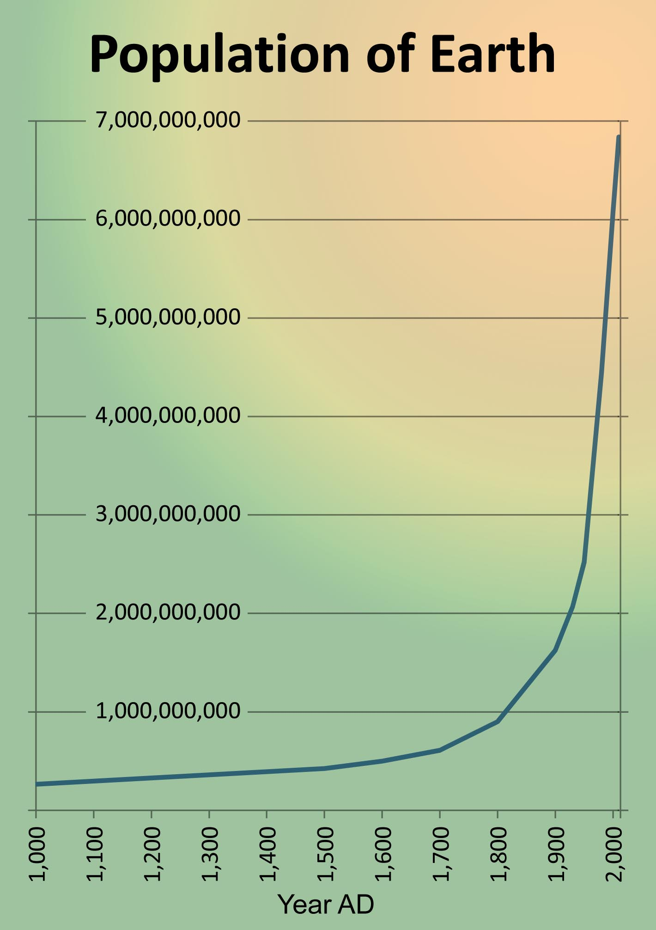
Short History of Climate Change 4
1990 - Claude Lorius predicts that increasing CO2 concentrations follow increasing temperature with glaciation caused by orbital cycles.
1992 - The Greenland Ice Core Project saw two identical two-mile deep ice cores reflect the same 27 abrupt climate changes in the last 110,000 years where Greenland temperature changed up to 40 degrees F in as little as a few decades and 20 degrees in less than several years.
1992 - President H.W. Bush signed the United Nations Framework Convention on Climate Change at the Earth Summit in Rio De Janeiro. The objective of the treaty was to stabilize greenhouse gas concentrations so as to avoid dangerous climate change. The Kyoto Protocol set the limits for obtaining this goal.
1997 - The Kyoto Protocol was officially adopted as the regulatory mechanism supporting the UNFCCC, to be rat
2001 - Three months after his inauguration, President G.W. Bush became the only leader of only four nations on Earth to not sign the Kyoto Protocol. The other three nations include Afghanistan, Andorra and South Sudan.

Slide 8
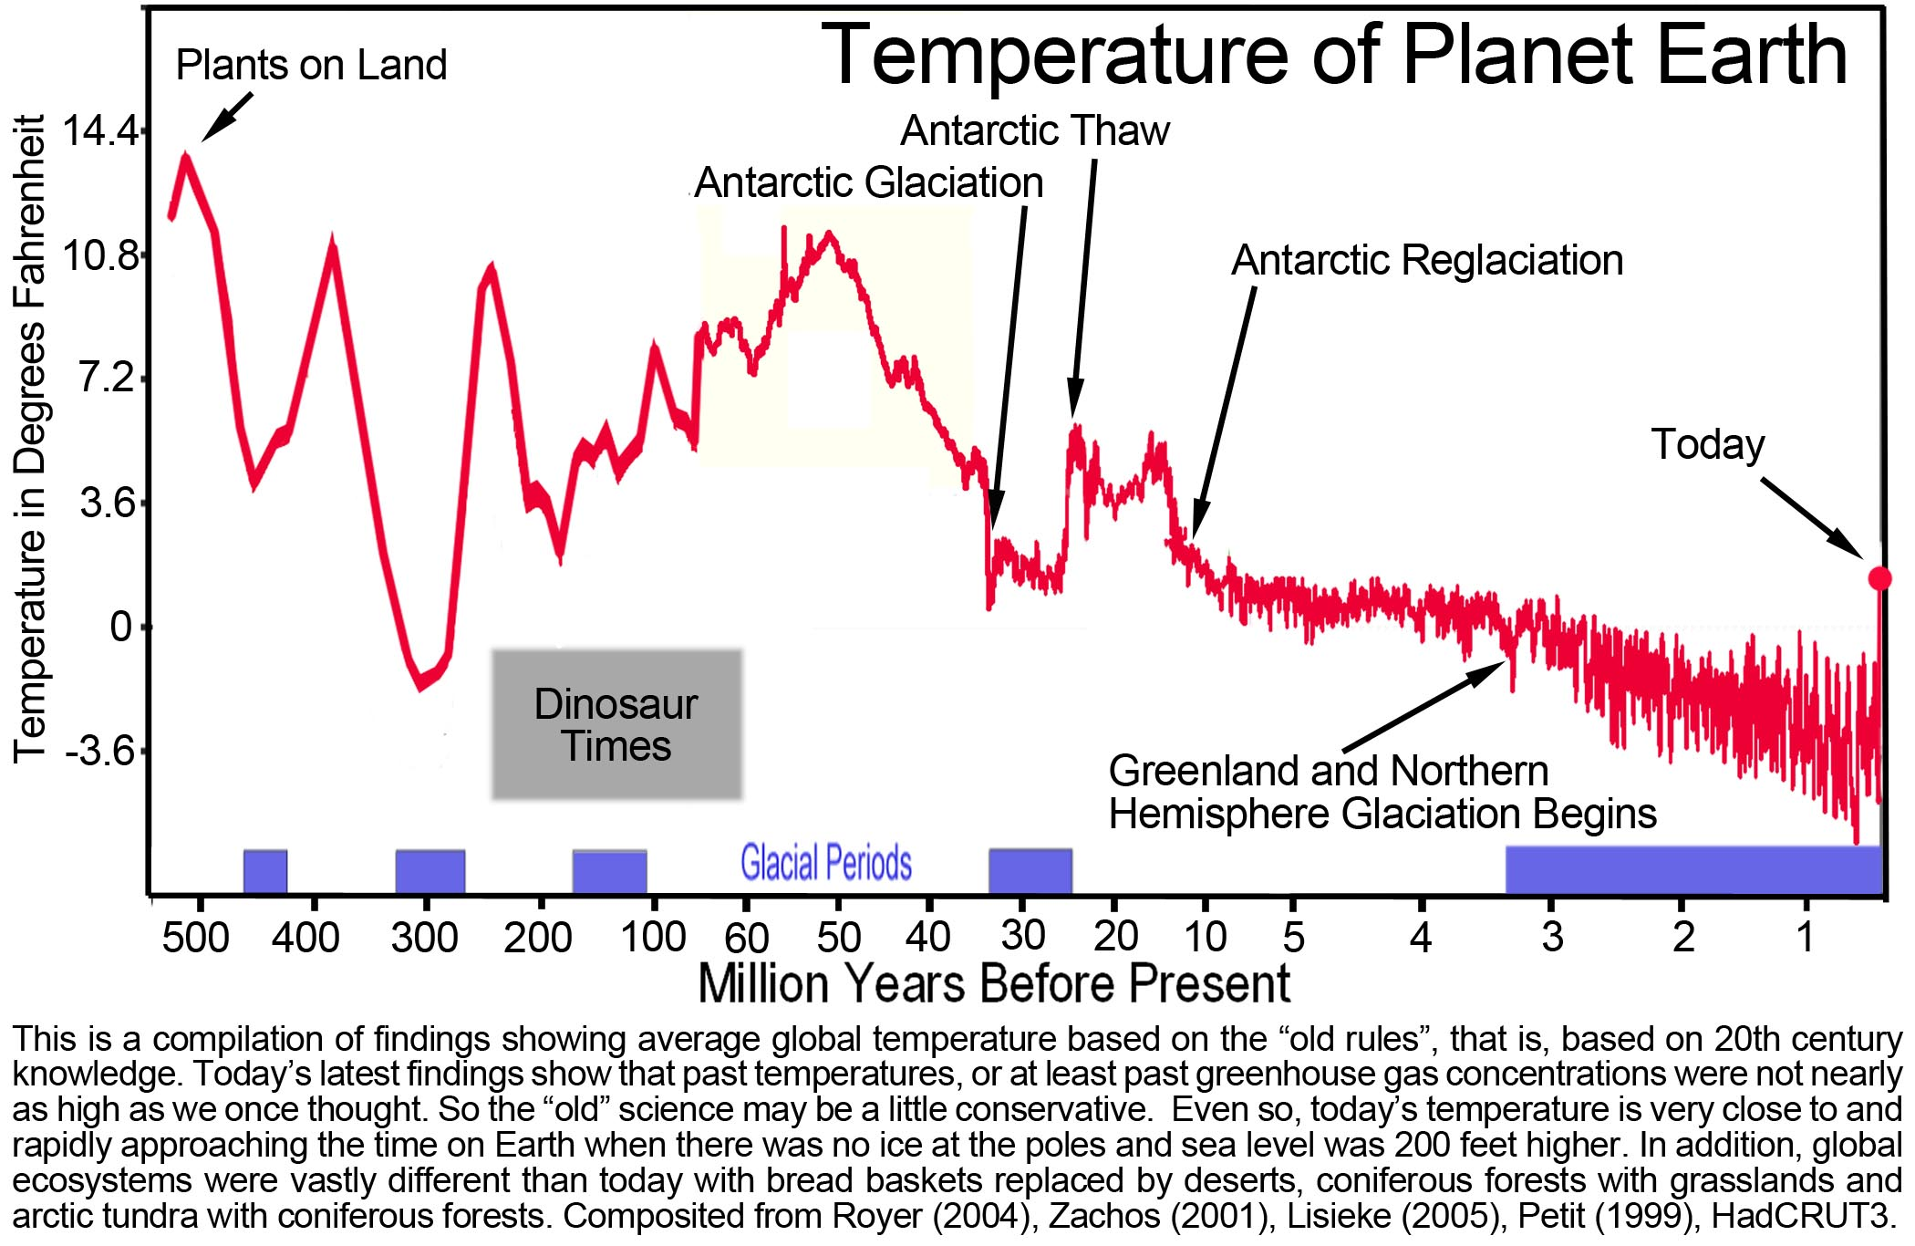
Climate Change Timeline 542,000,000 yr

Slide 9
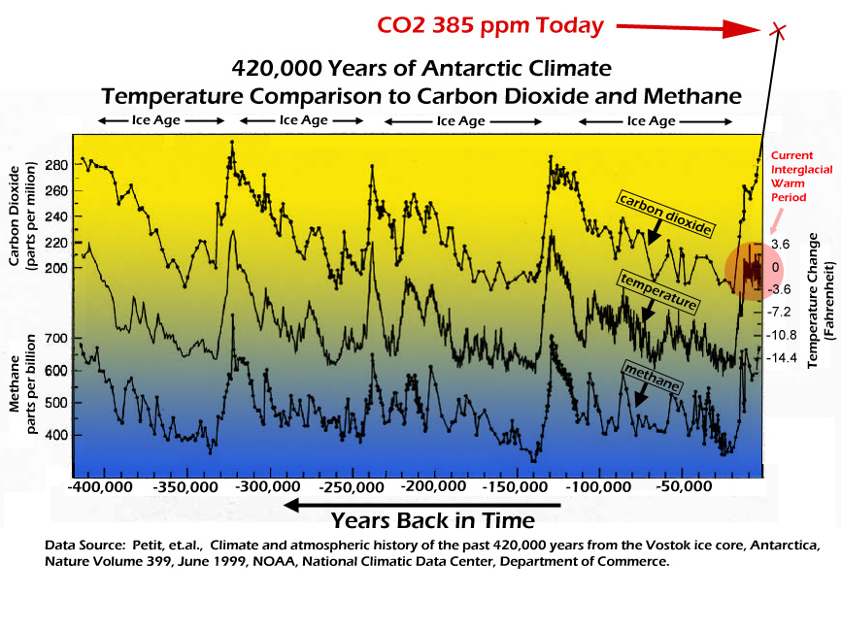
Climate Change Timeline 420,000 yr bp

Slide 10
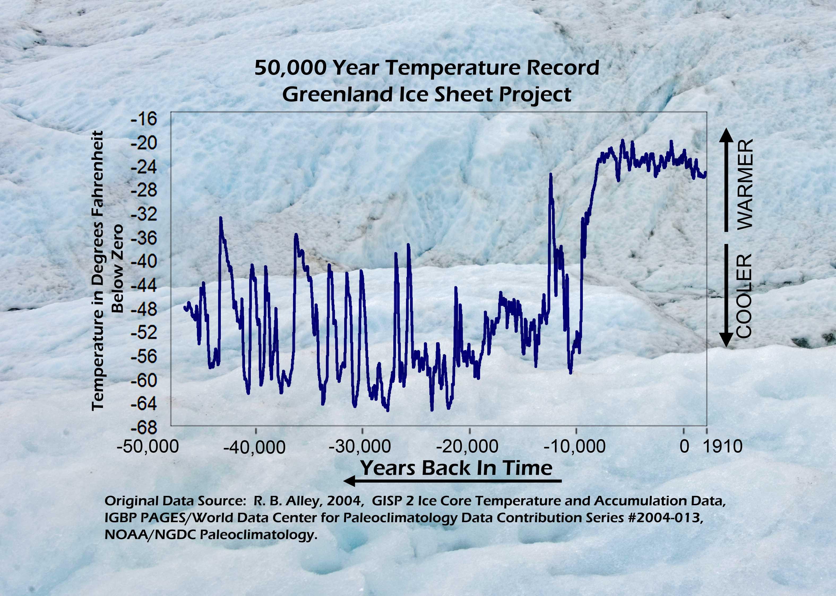
Climate Change Timeline 50,000 yr

Slide 11
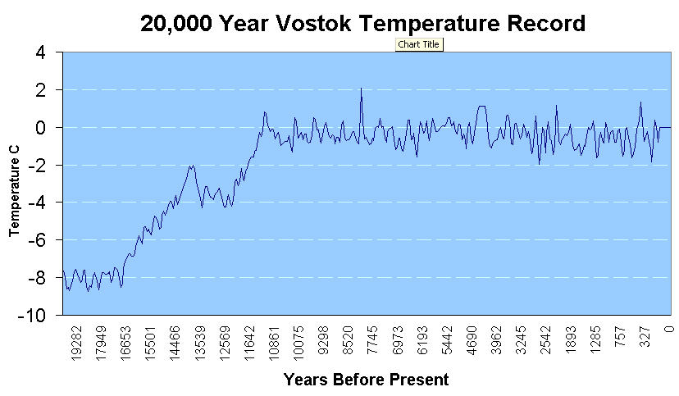
Climate Change Timeline 20,000 yr

Slide 12
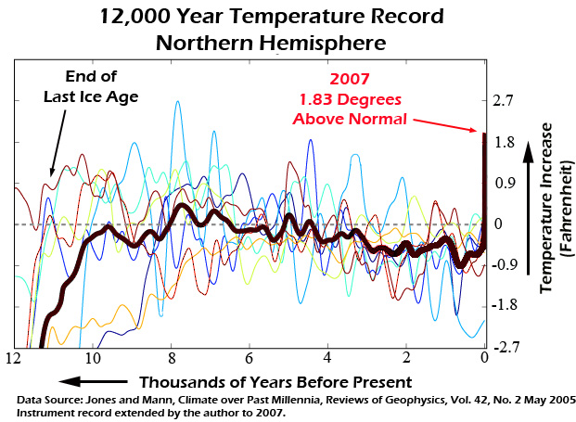
Climate Change Timeline 12,000 yr

Slide 13
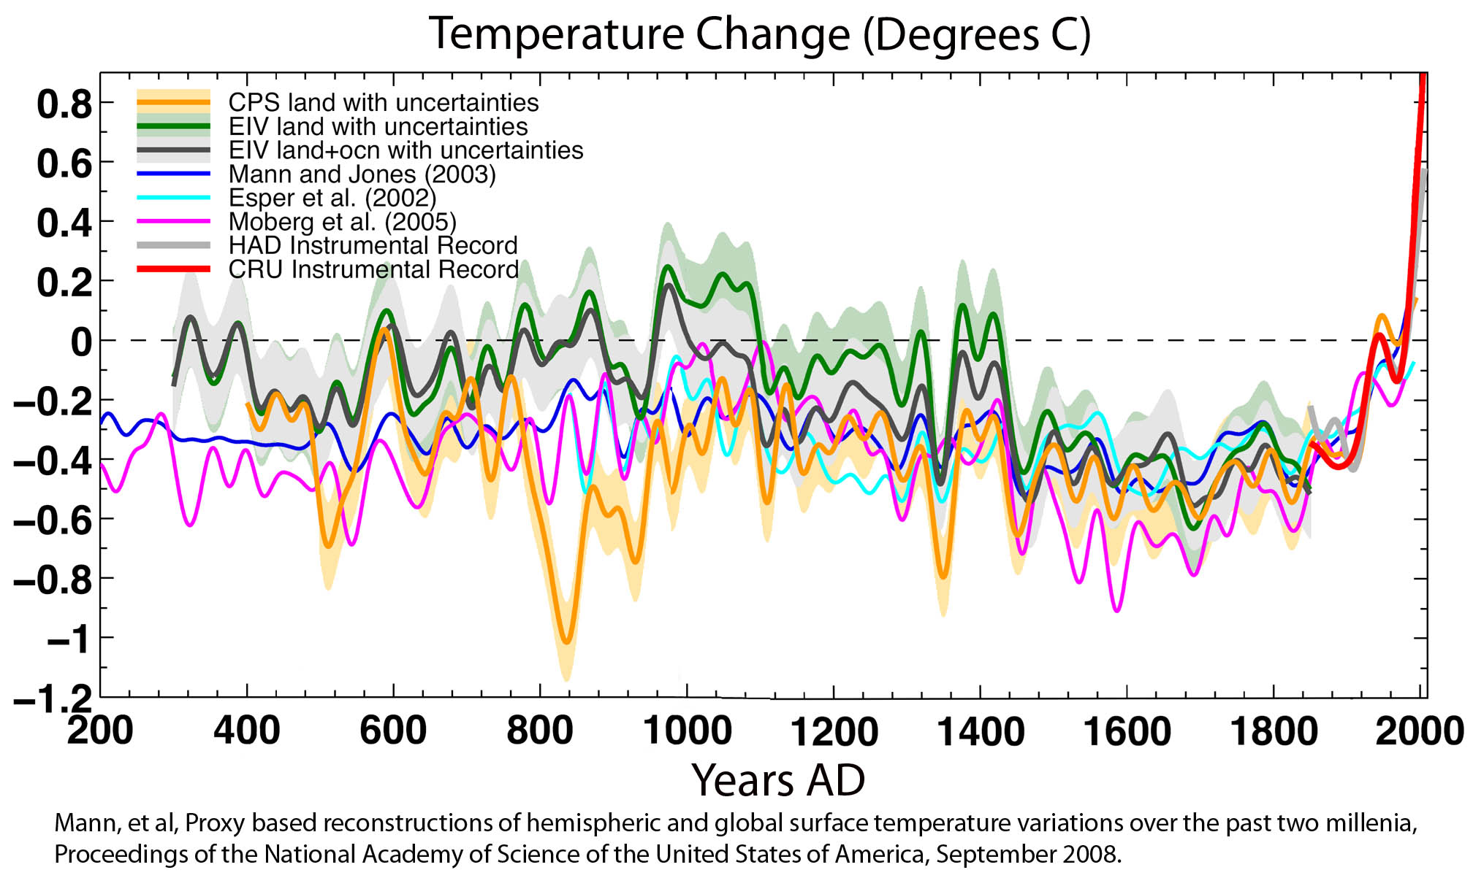
Climate Change Timeline 1850 to Present

Slide 16
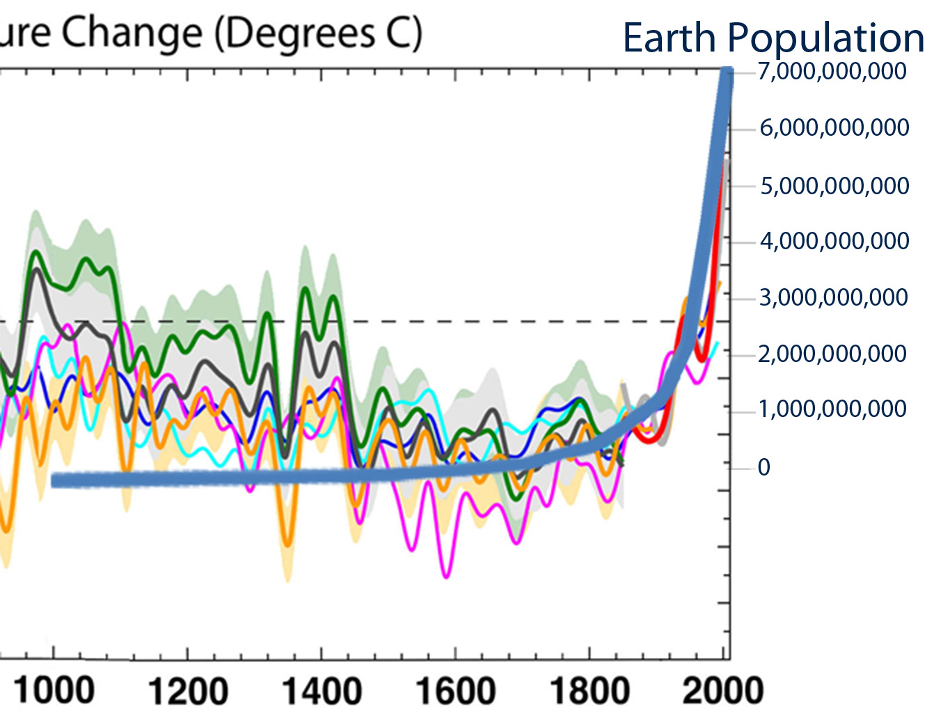

Slide 17
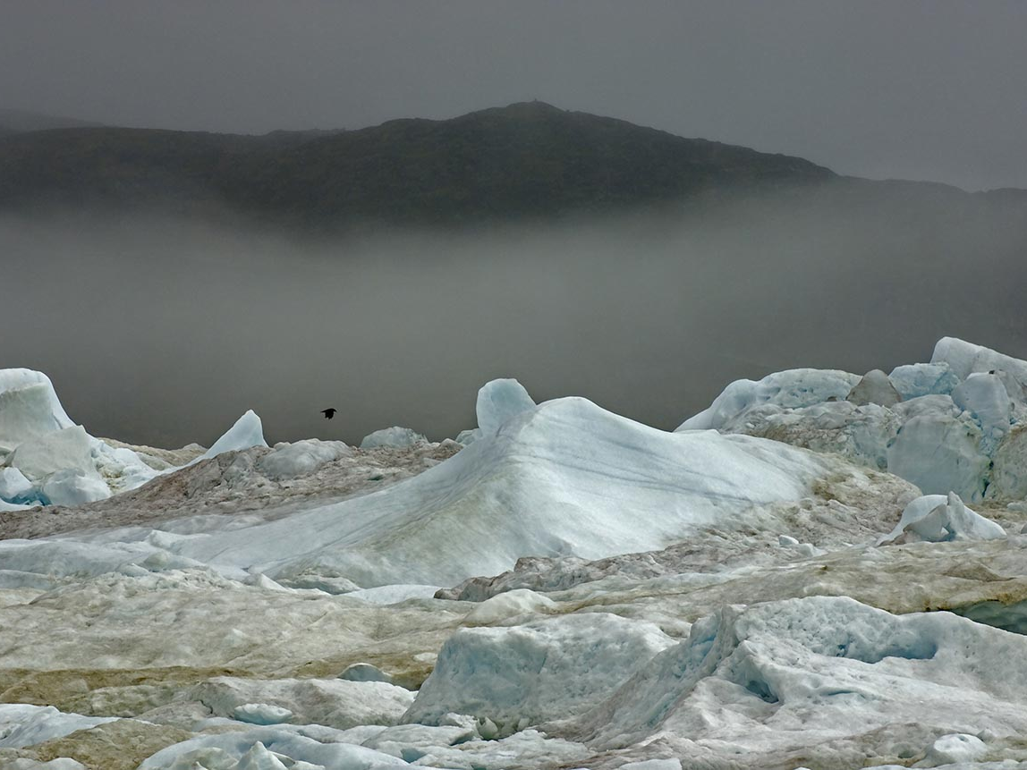
The Science Was Settled in the mid 1990s

Slide 18
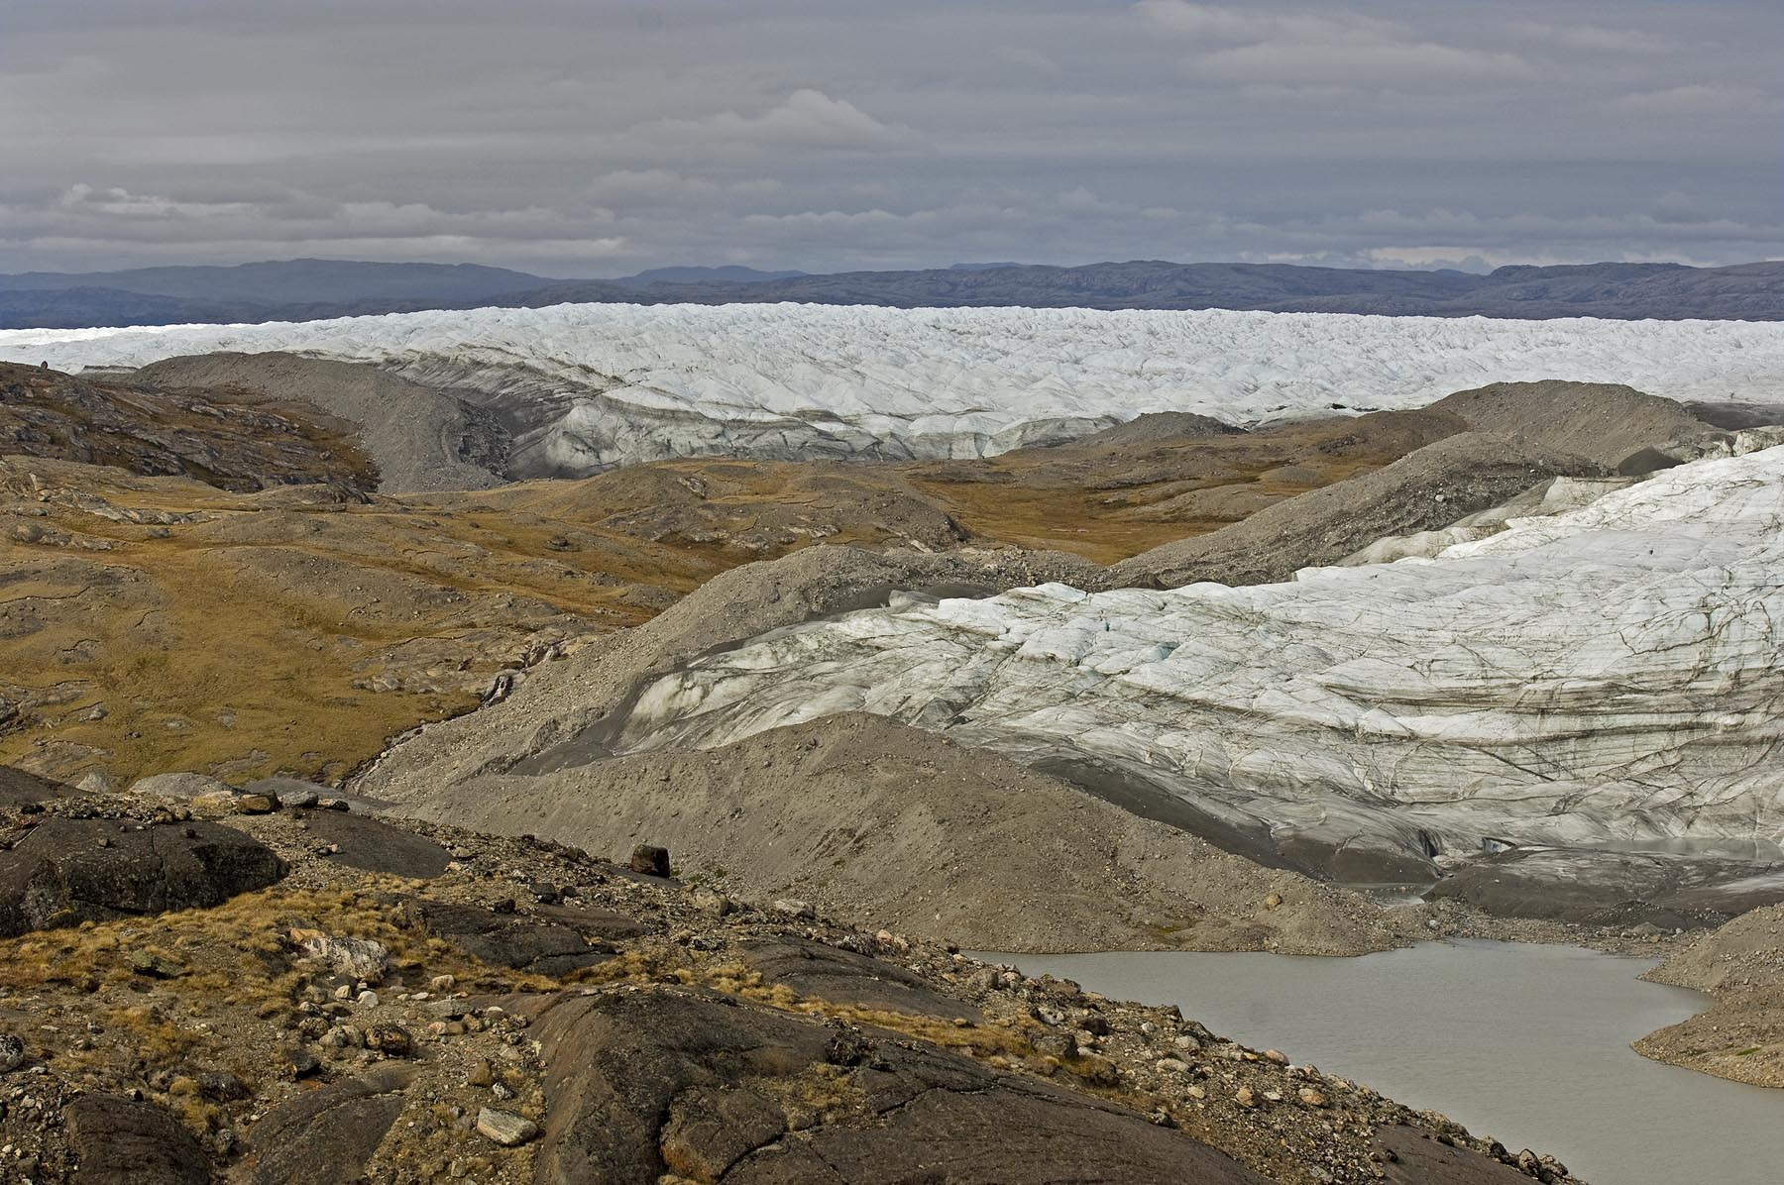
Greenland Ice Cores
Point 660, Kangerlussuaq, West Coast of Greenland

Slide 19
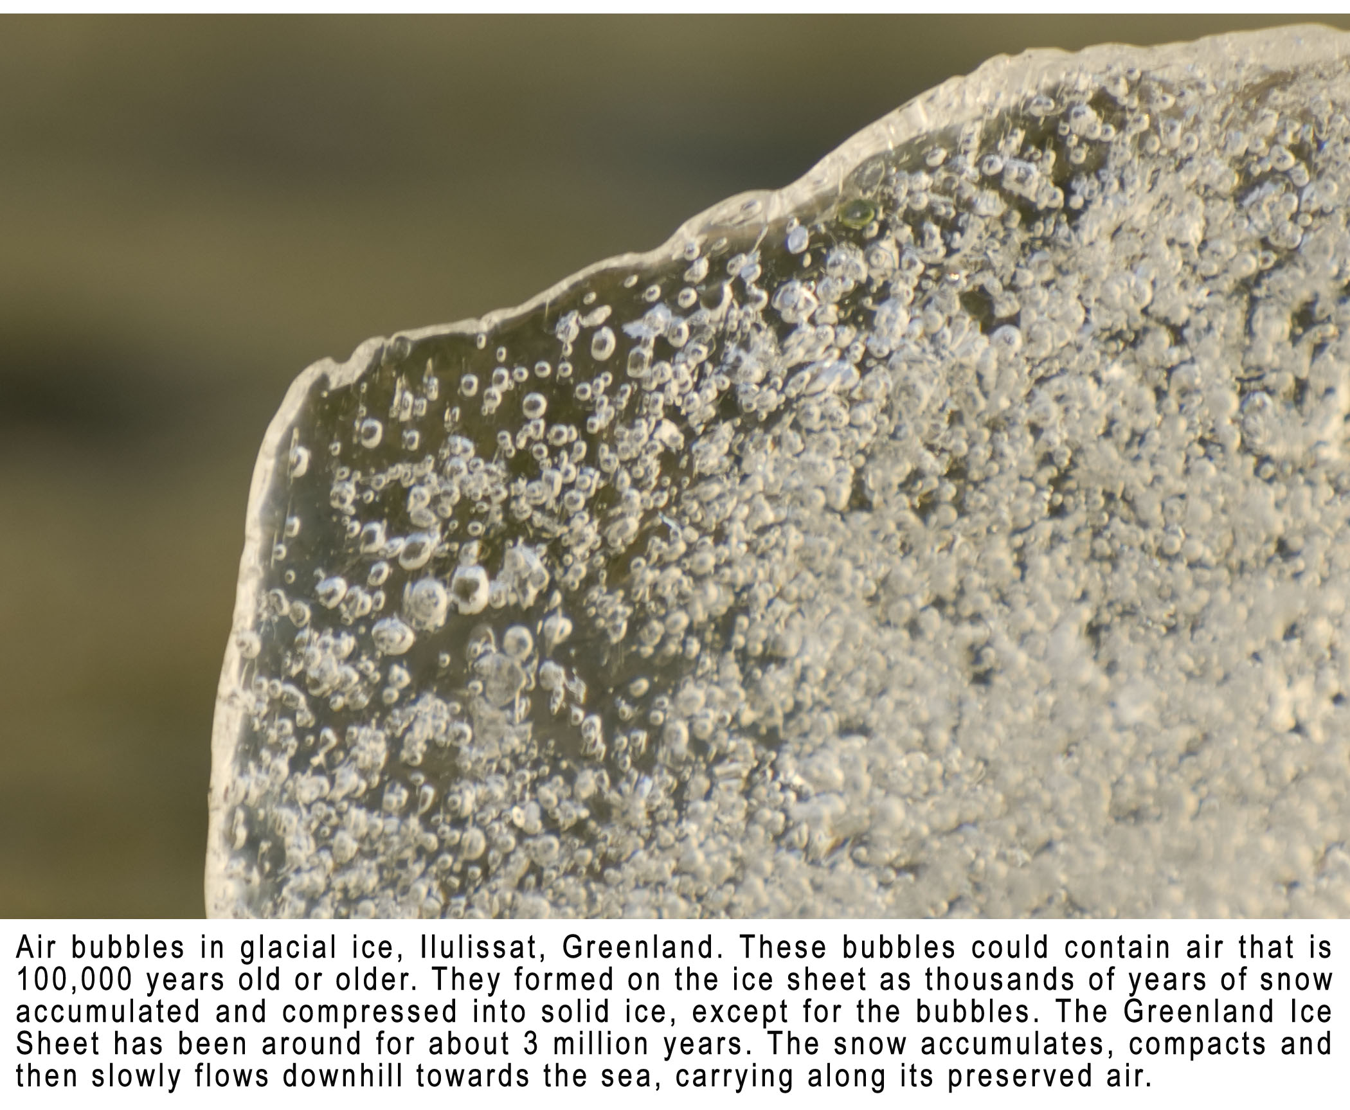

Slide 20
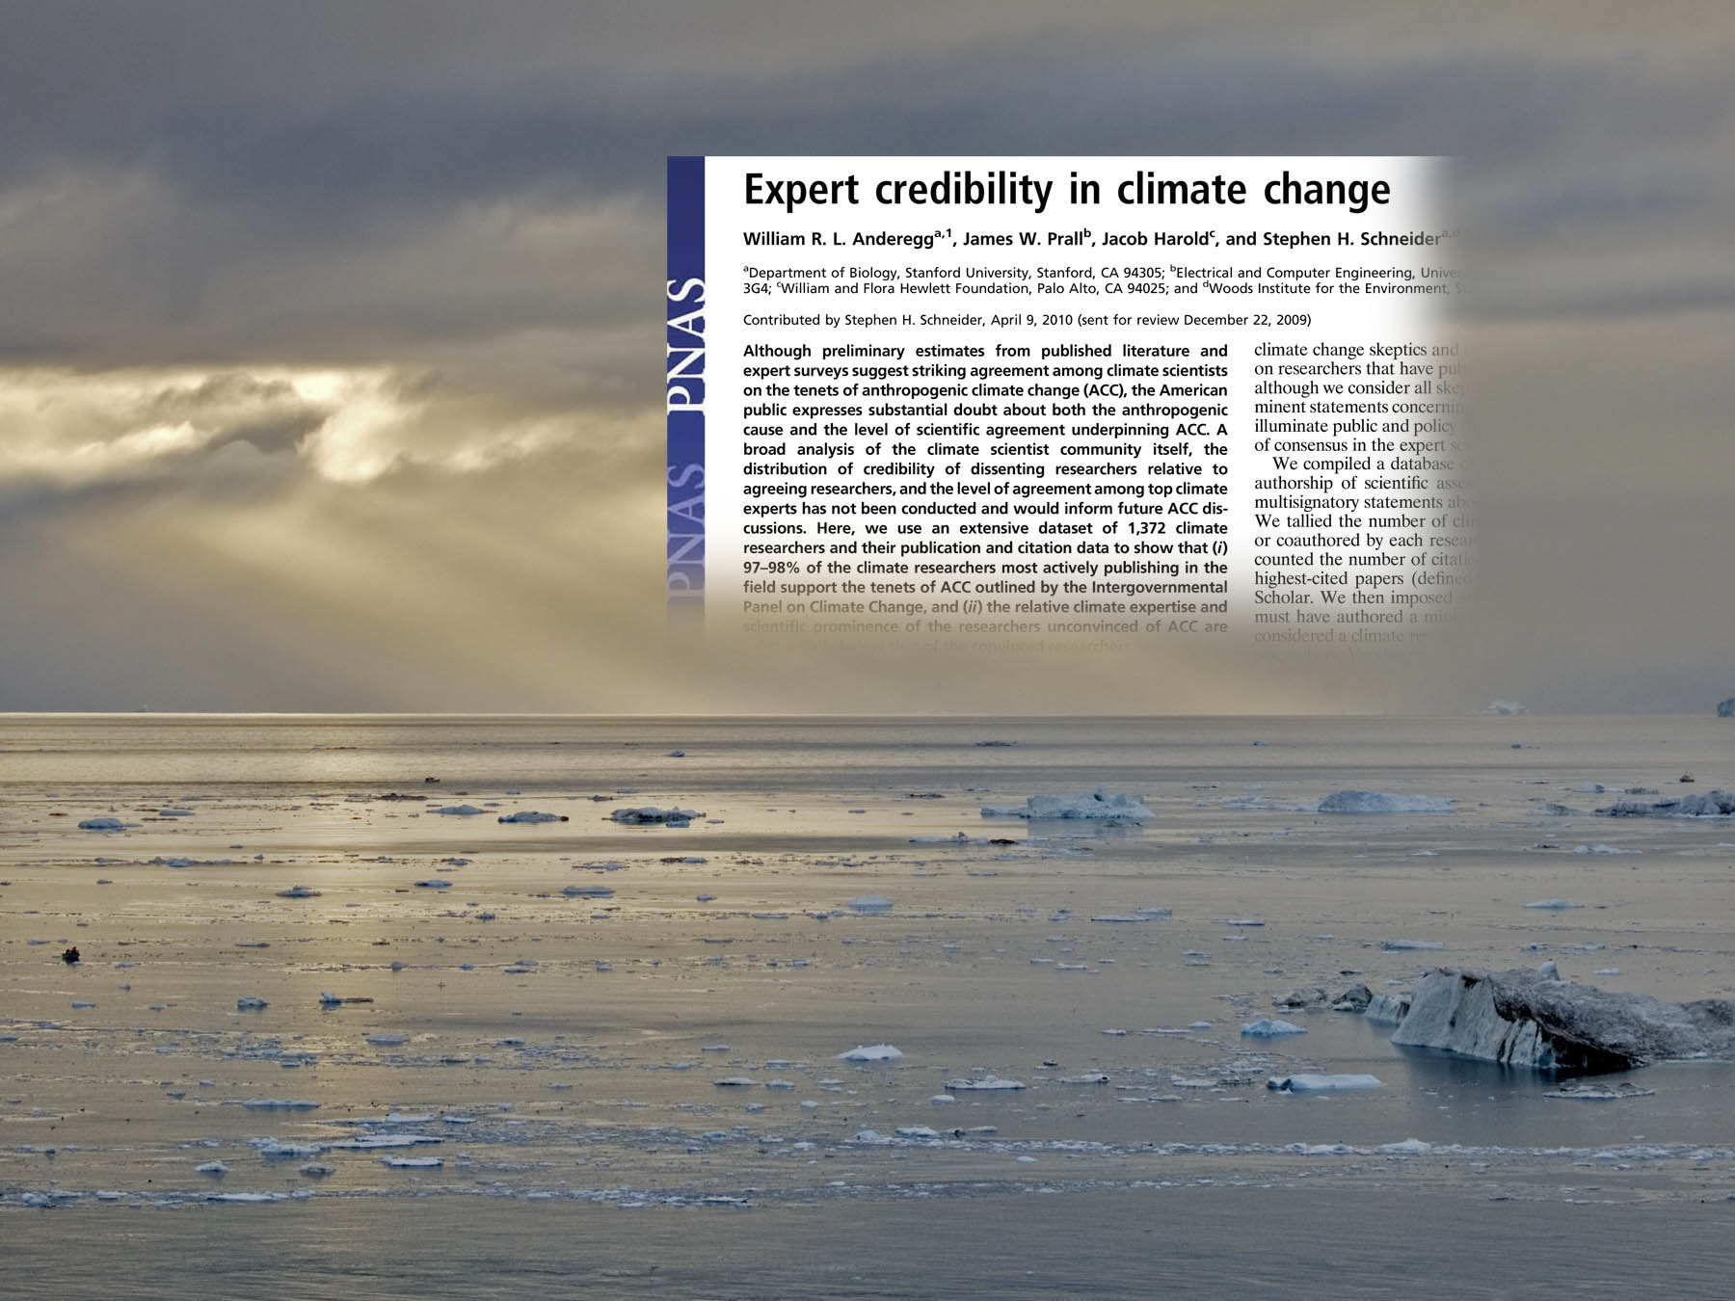

Slide 21
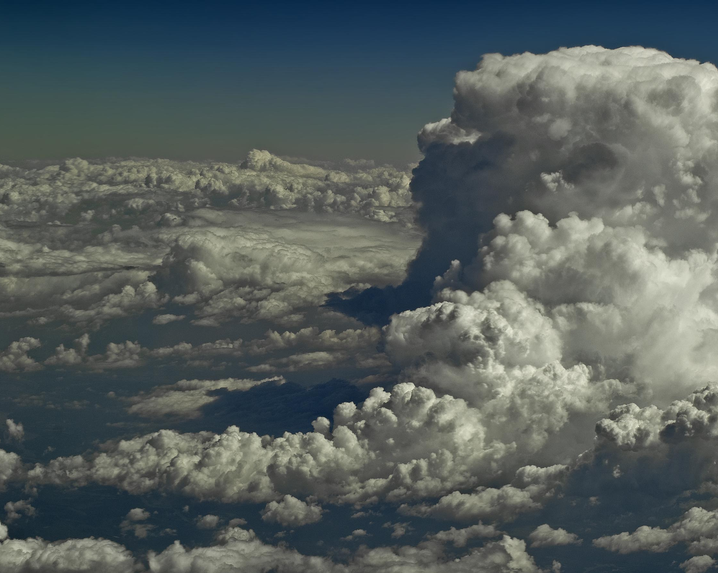
Between 97 and 98 percent of the most actively publishing climate scientists agree on the consensus position concerning climate change. Of the 2 to 3
percent that do not agree, 80 percent have published
fewer than 20 papers each on climate. Of the vast
majority, 90 percent have published greater than
20 papers each on climate science.

Slide 22
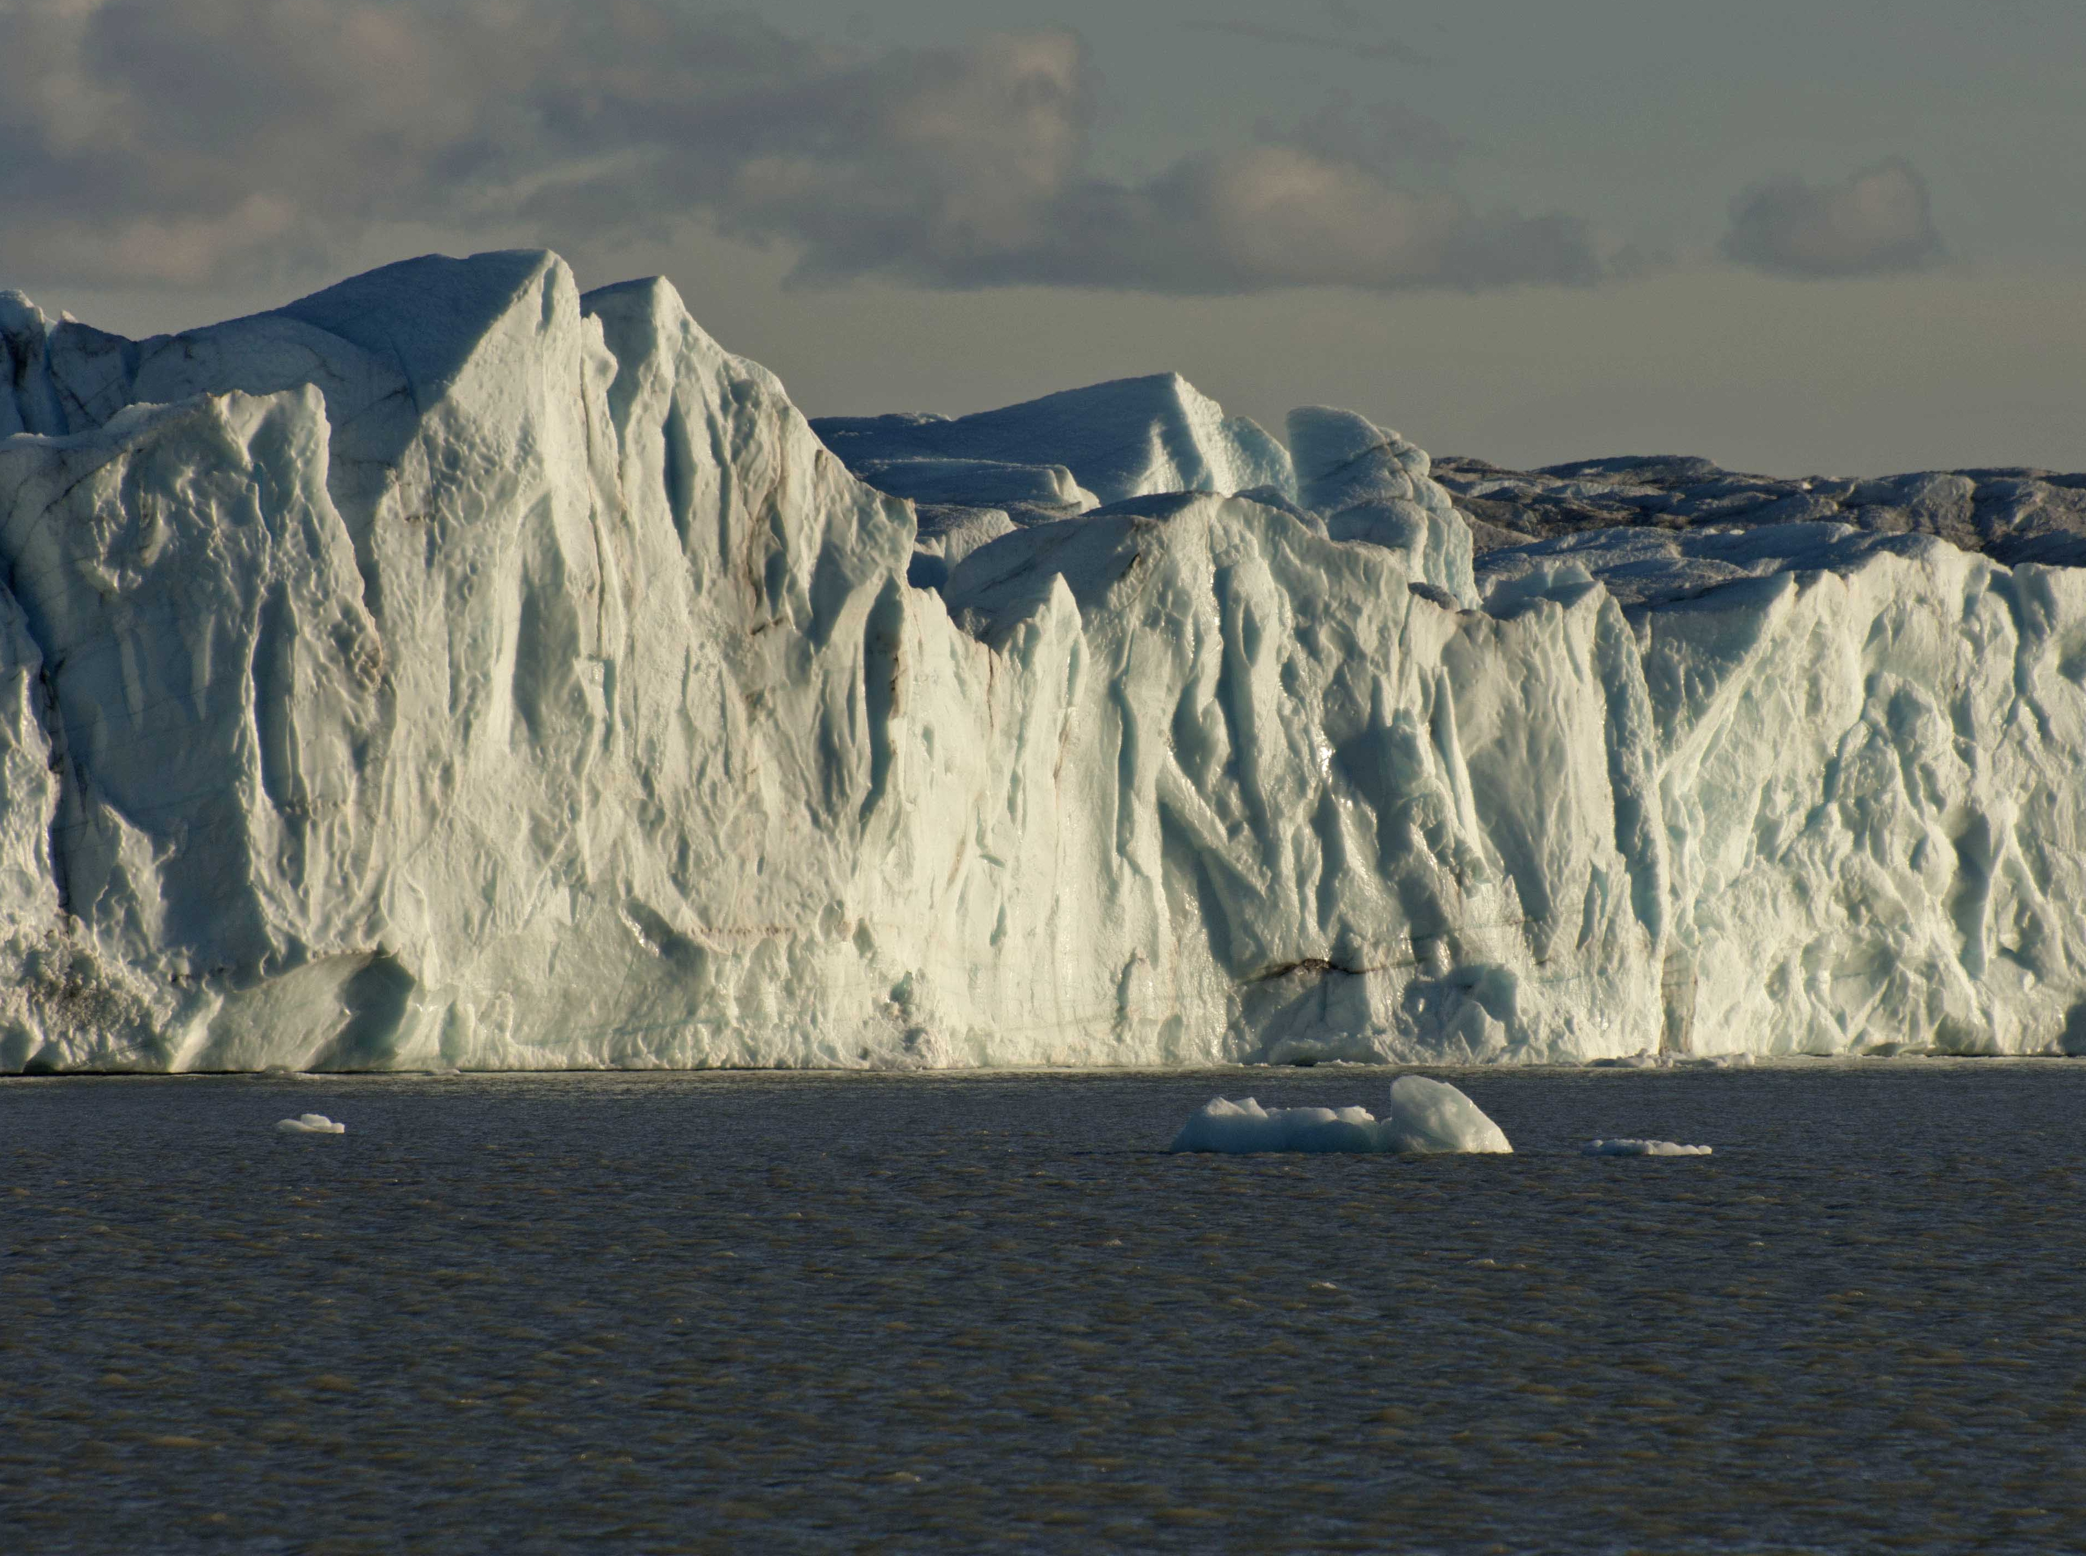
Not only are there far, far fewer in the 2 to 3 percent group, but they have far, far fewer credentials.

Slide 23

So why is climate change such a controversy?

Slide 24
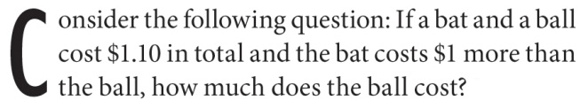
A) $0.10 B) $0.05

Slide 25
B) $0.05

Slide 26
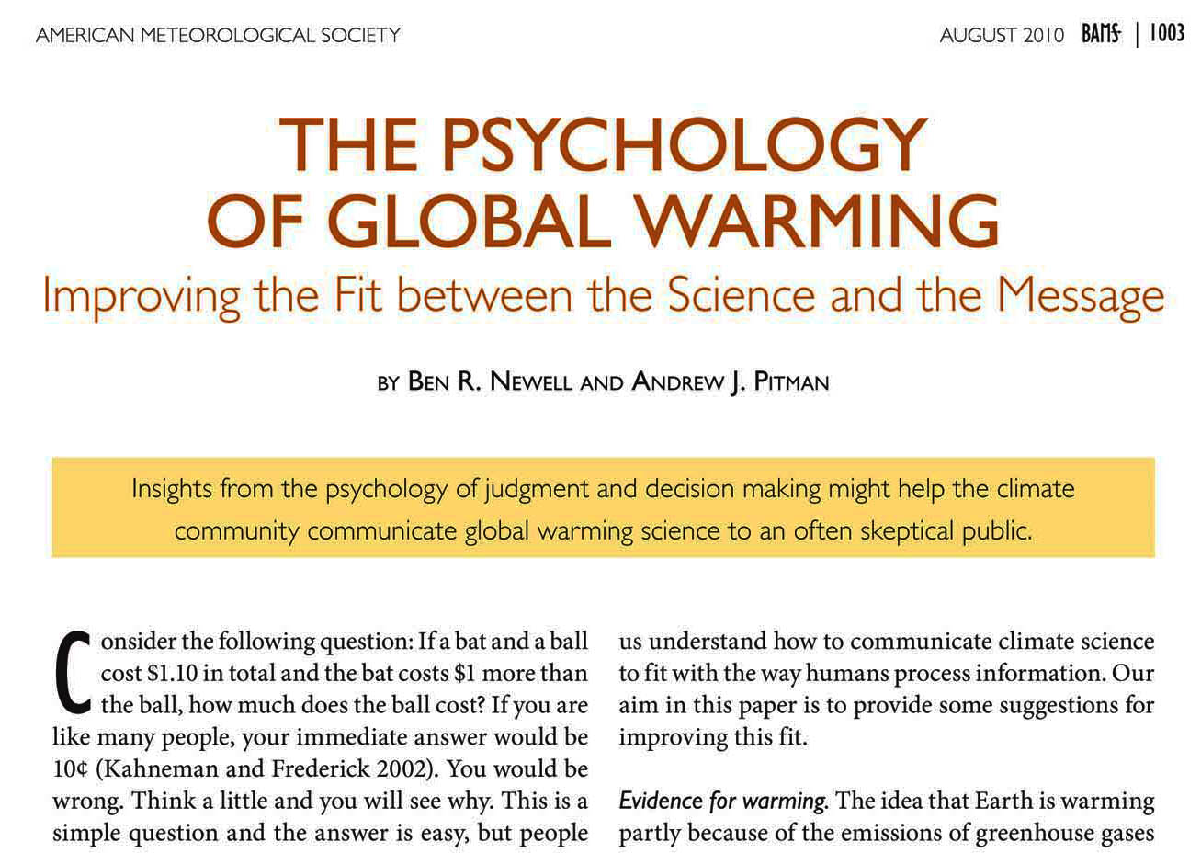
http://journals.ametsoc.org/doi/pdf/10.1175/2010BAMS2957.1

Slide 27
We all know what climate is. It’s the difference between a desert and a forest, a mountainous climate or a coastal climate, a rainforest of arctic tundra. Climate is something we run away from in Minnesota in winter or run towards in Florida at spring break. It’s something we go to a more favorable one when we are sick . It’s a different place where we vacation. It’s what’s staring us in the face when we walk out the front door every morning. It’s the topic of conversation around the coffee pot almost every day. We get a does of it in our forecast every eight minutes on the minute, at 6 and 10 every evening, in the lower right hand corner of the front page of every newspaper on the planet.
It’s what the weatherman and the weathergirl can’t get right in the seven day forecast.
But none of this is the climate that is so important in this conversation. All of that stuff above is weather, or different environments. Climate is about all averaged weather. This is all weather occurring everywhere and averaged not over periods that are basically geologic in scale.

Slide 28
We all know what climate is.

Slide 29
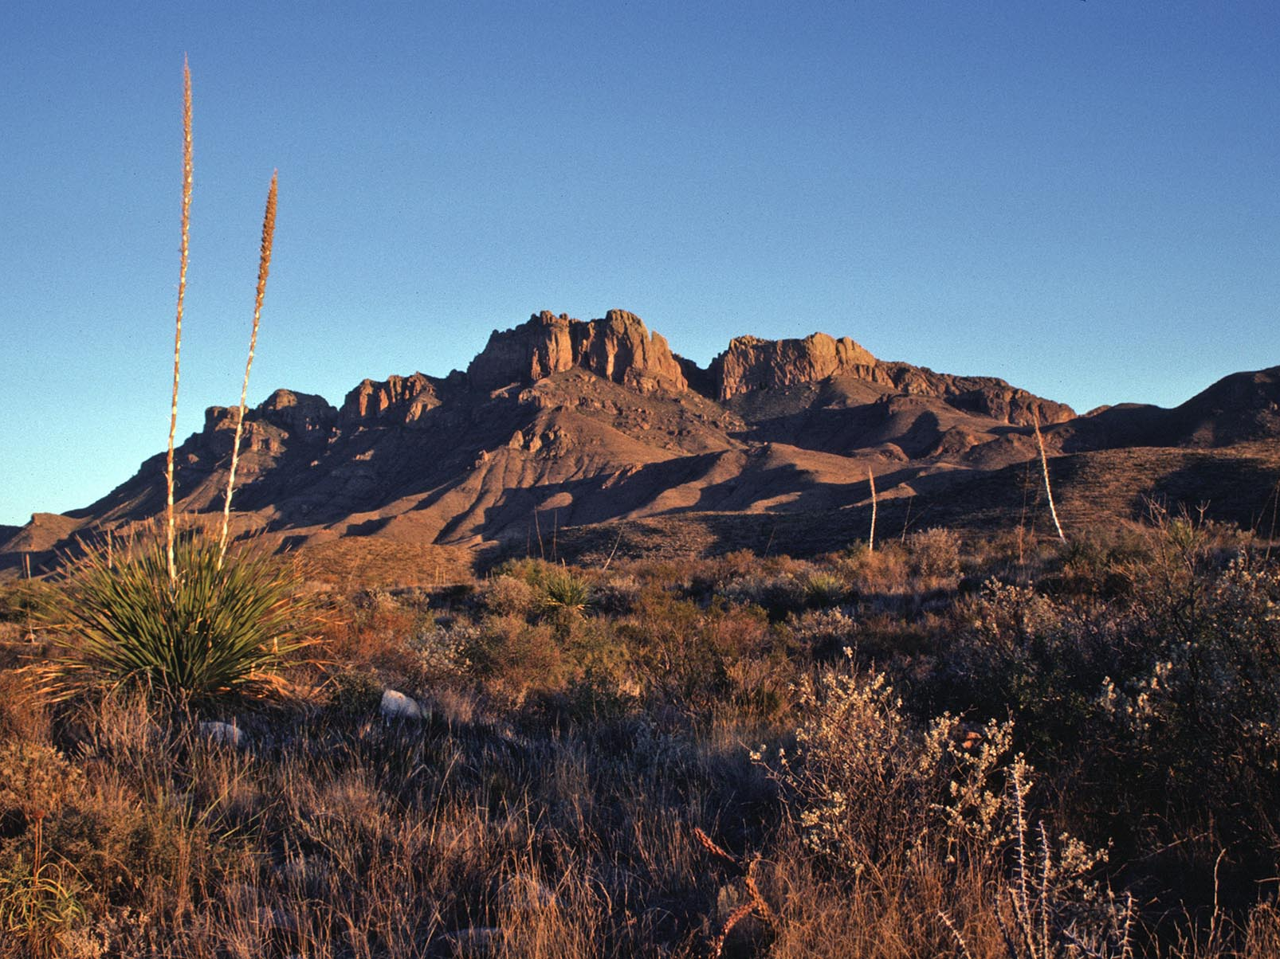

Slide 30
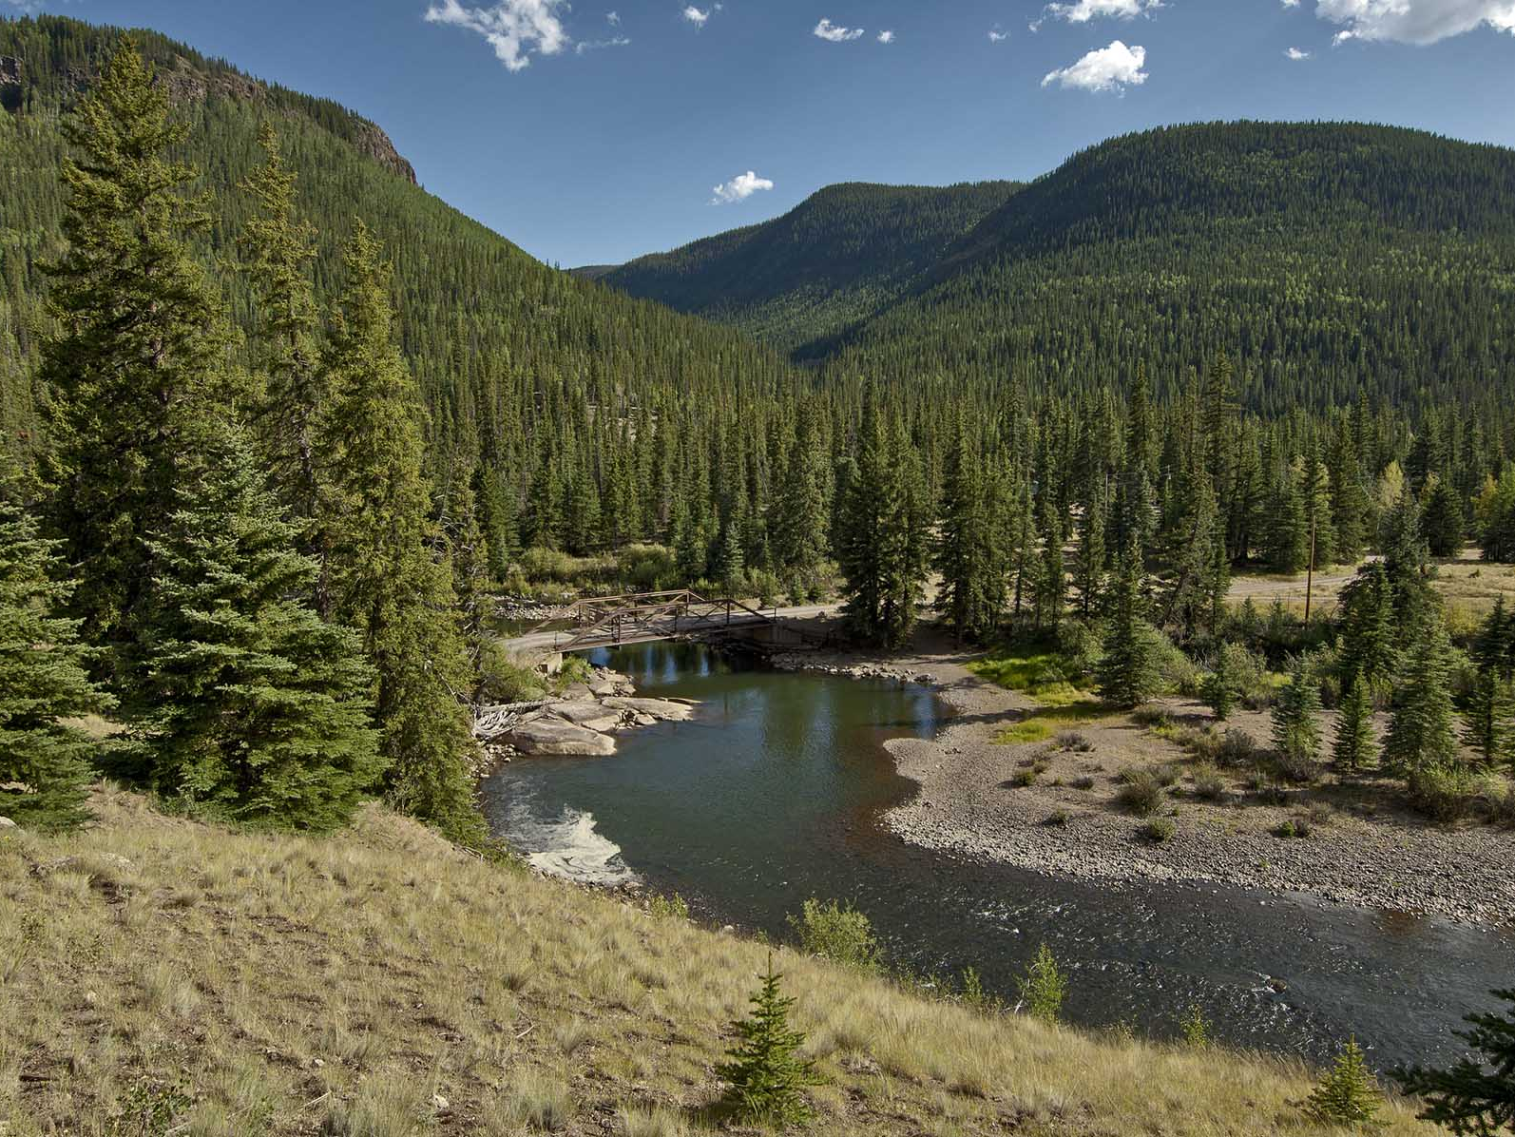

Slide 31
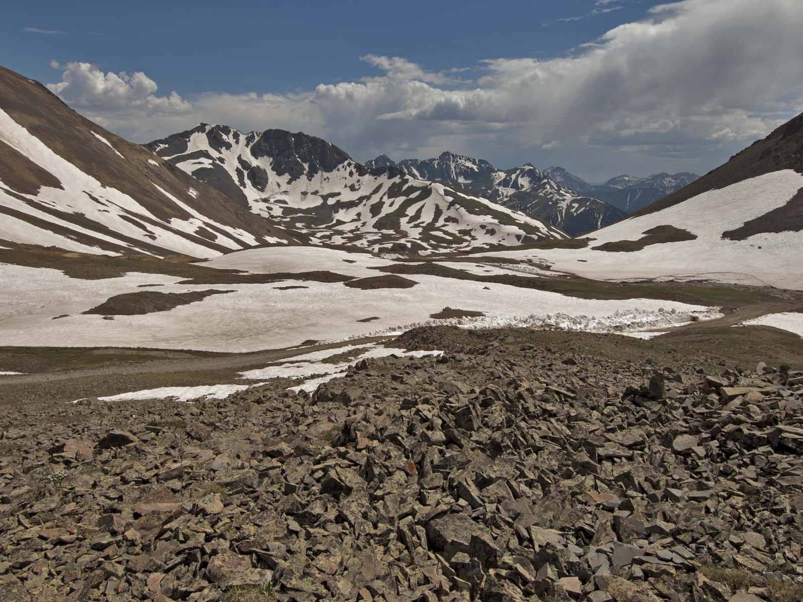

Slide 32
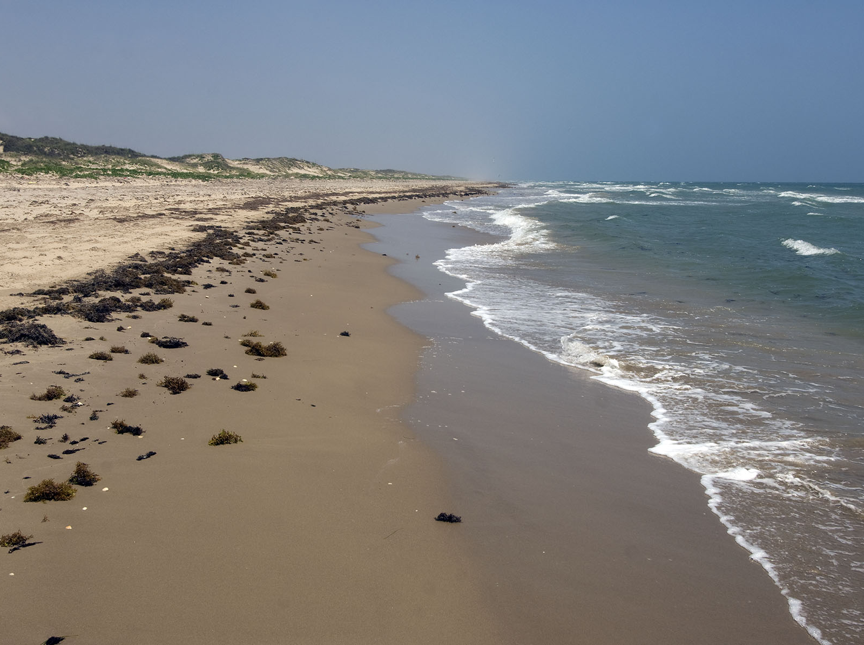

Slide 33
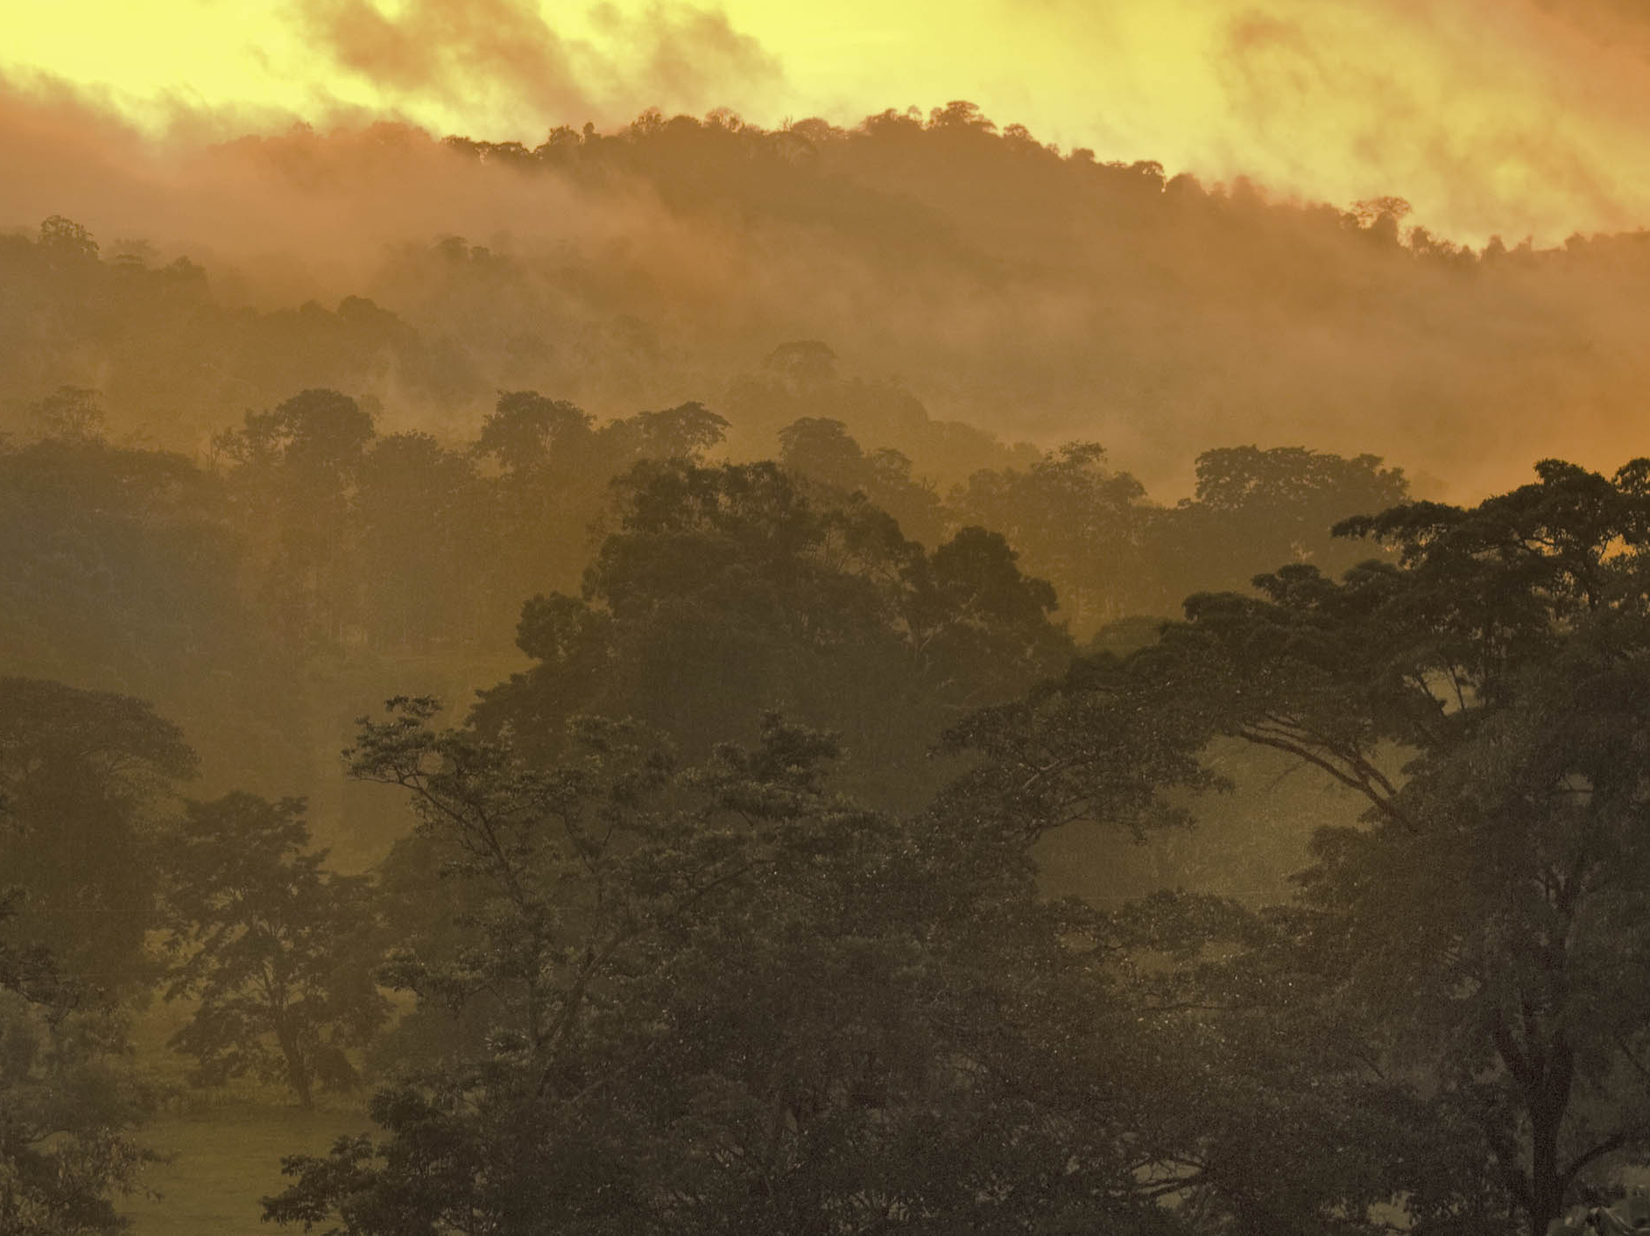

Slide 34
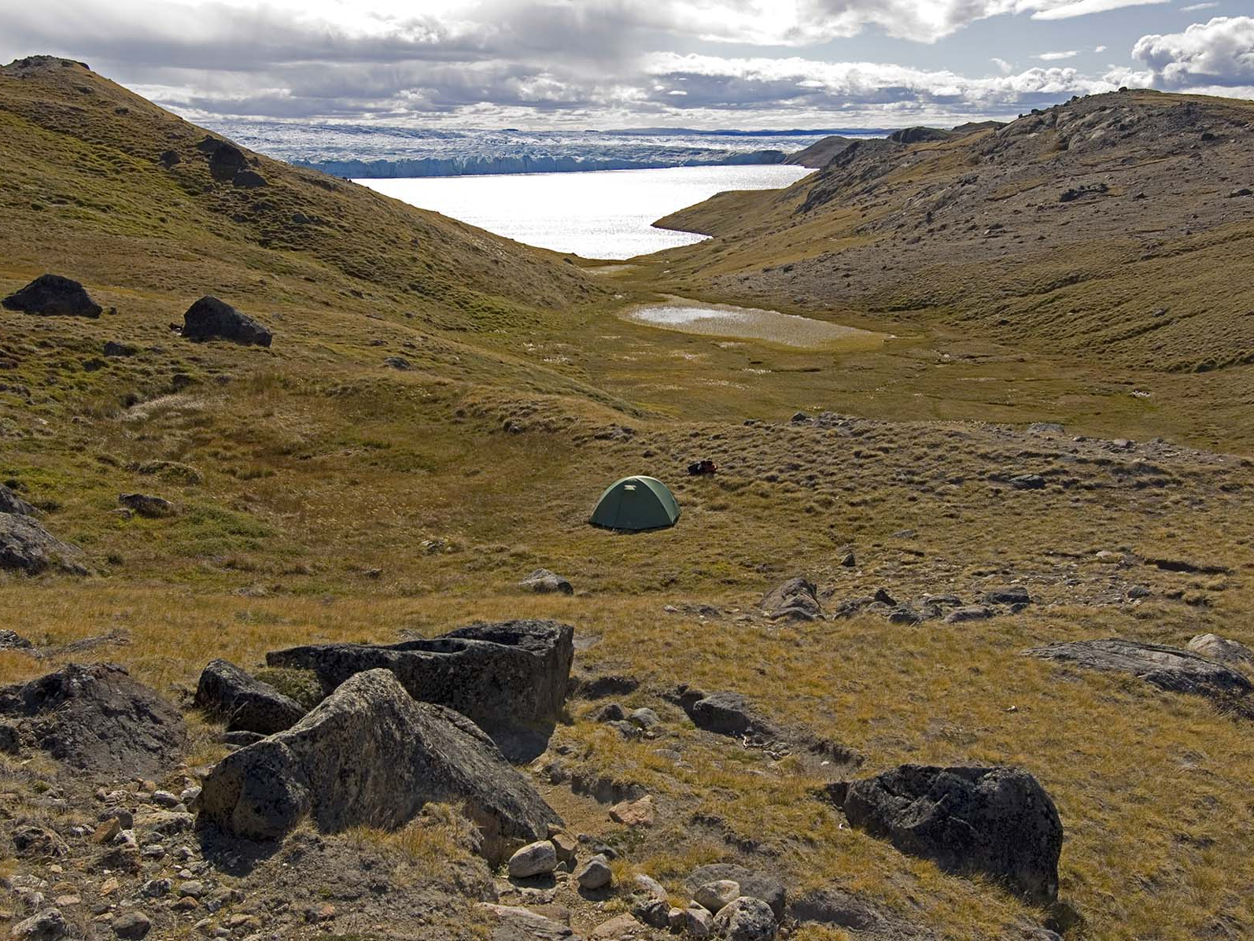

Slide 35
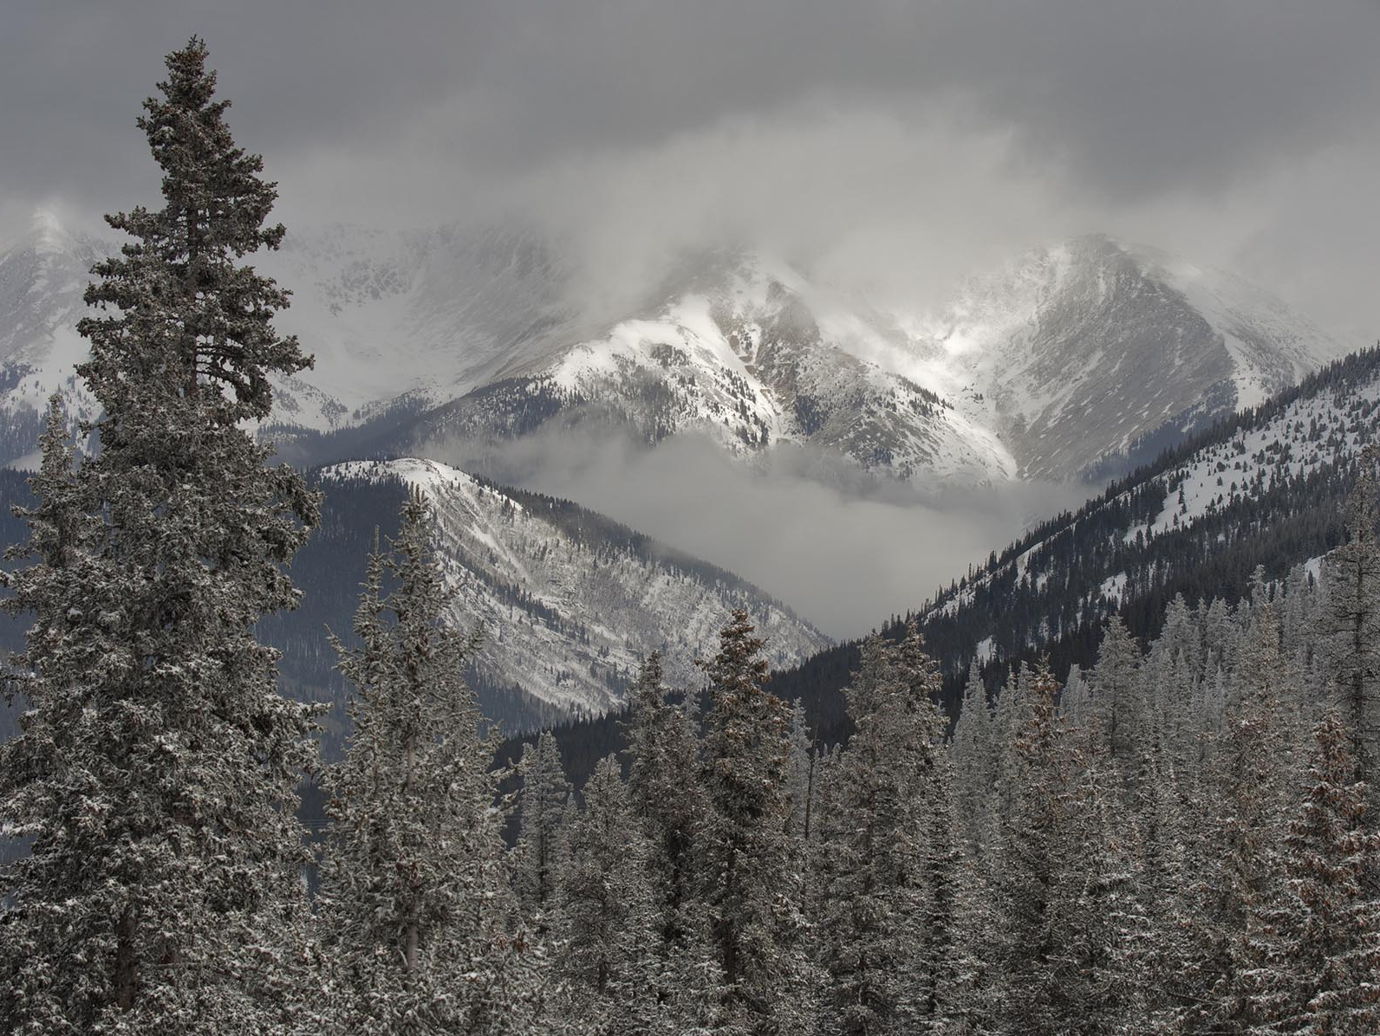

Slide 36
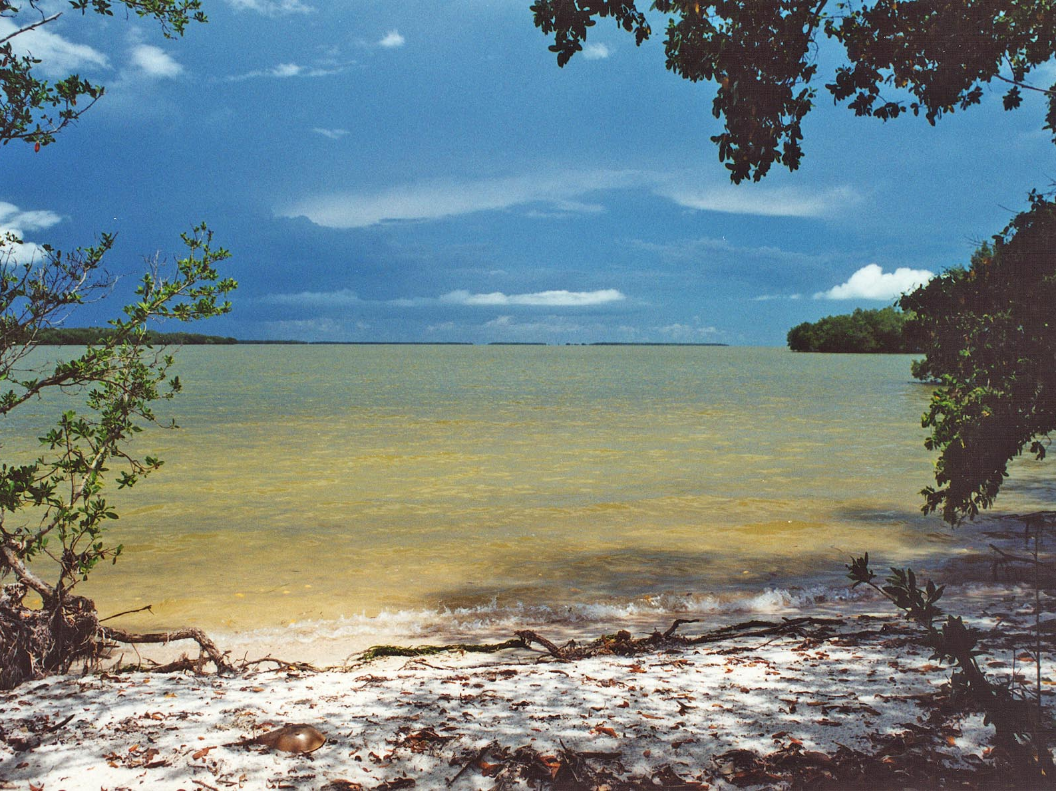

Slide 37
It’s counter intuitive that a few degrees of change could make a difference.

Slide 38
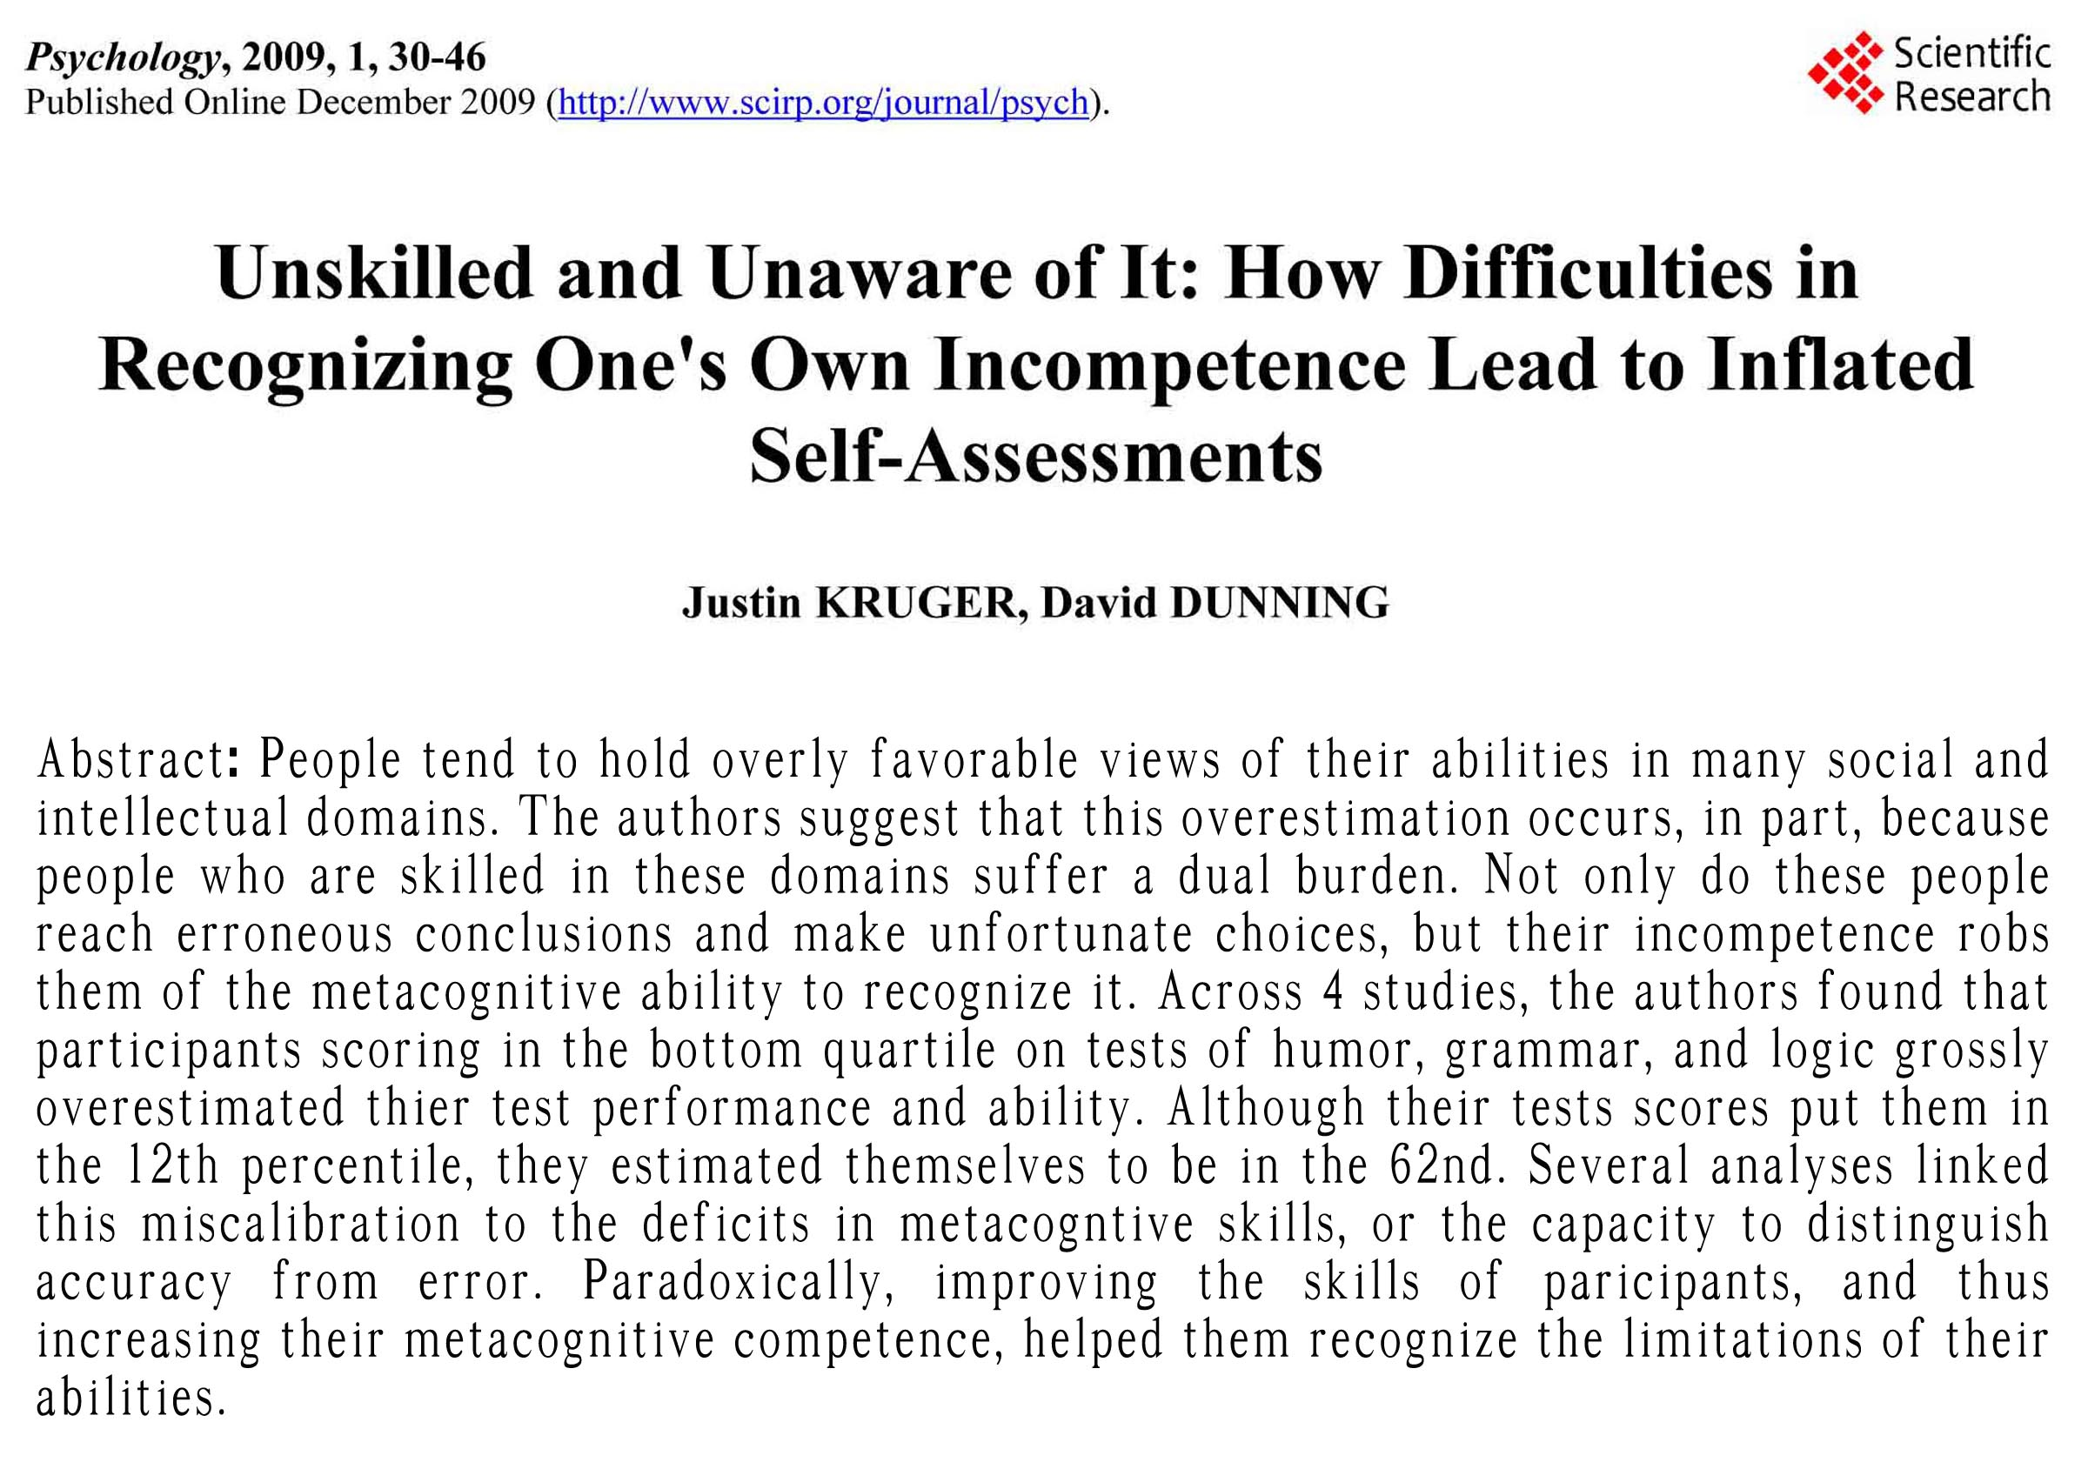
http://www.math.ucdavis.edu/~suh/metacognition.pdf

Slide 39
It’s Darned Complicated
Cryologist – Doctor of ice science
Podiatrist – Doctor specializing in feet
Paleobotanist – Doctor trained in the study of ancient plants
Oncologist – Doctor specializing in cancer
Paleotempestologist – Doctor specializing in hurricanes and typhoons from the ancient past
Neurosurgeon – A doctor specializing in brain surgery
Glaciologists specialize in glaciers
Meteorologist – A specialist in weather happening now, limited in geographic scope and looking 30 years of records and weeks or months into the future.
Pediatrician – Doctor specializing in children and infants
Climatologist – similar to a meteorologist, trained in climatology: the last 30 years of weather. Works a lot with agriculture.
Climatologists are specialists in the last 30 years of weather and predictions for weeks, months or a few seasons into the future.
Climate scientists deal in weather time frames that begin at 30 years and extend for tens of thousands and even million of years in the past and hundreds of years into the future.

Slide 40
There are “voices” out there that would have us believe that climate change is not real, is a conspiracy, a natural cycle that will soon end, or is good for human society.

Slide 41
These voices rely on scientists who belong to the 2 to 3 percent minority, or non-specialist authority figures.
But mostly they rely on scientists that are not specialists in climate.

Slide 42
And mostly, they rely on repetitive propaganda, disproven way out of proportion to other science issues in the literature, yet the arguments still keep coming back.
The urban heat island as it applies to Austin in a minute.

Slide 43
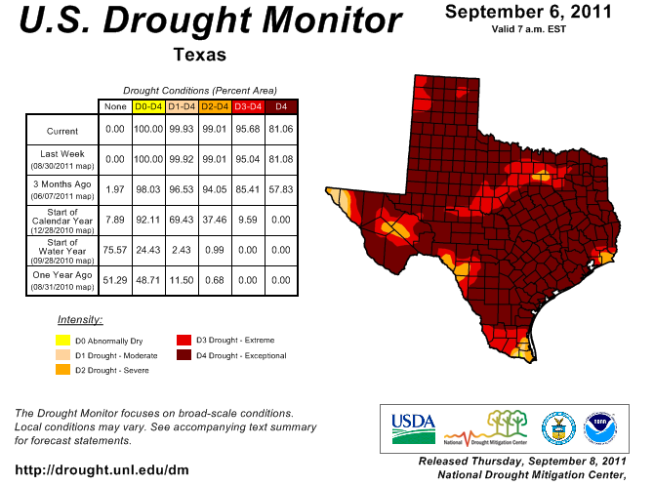

Slide 44
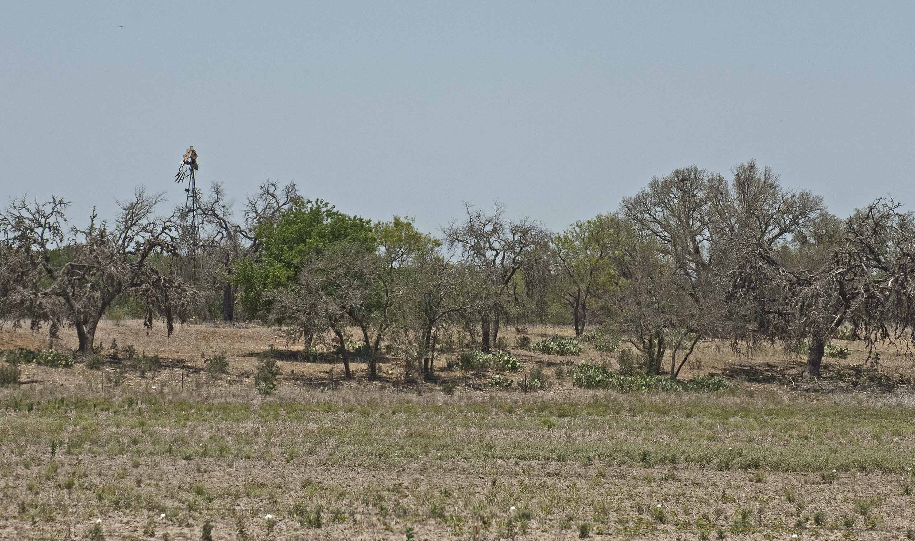
Central Texas Tree Kill East of Kerrville

Slide 45
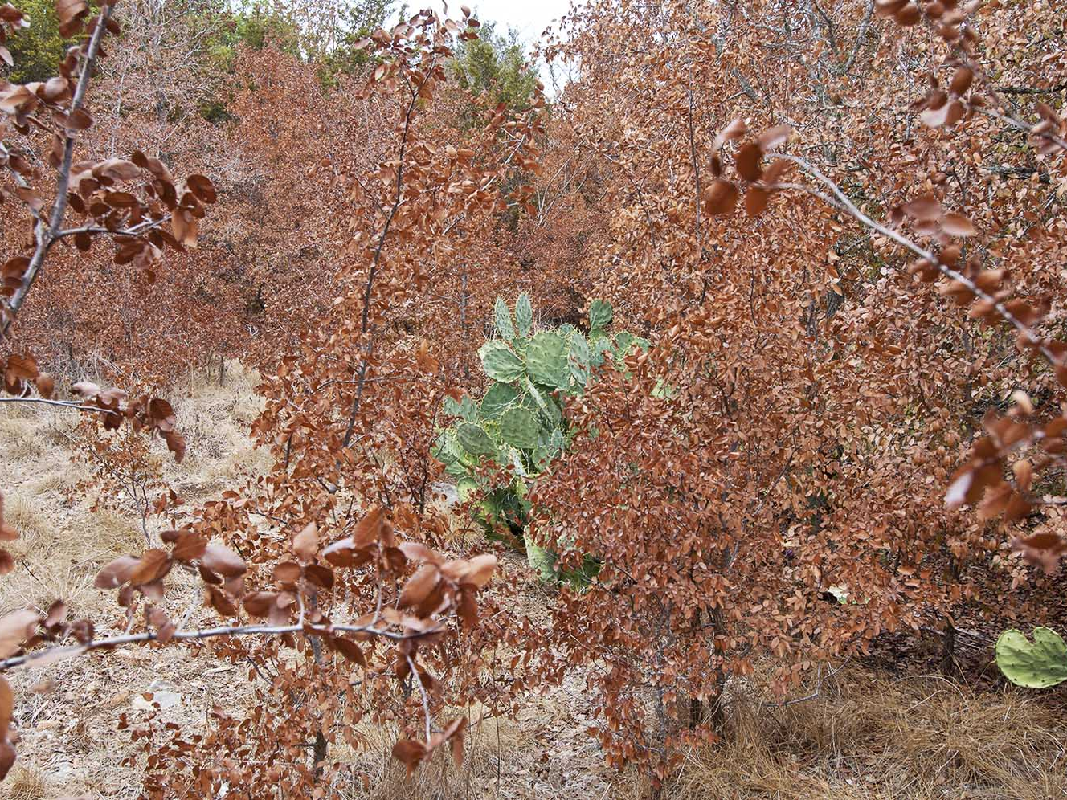

Slide 46
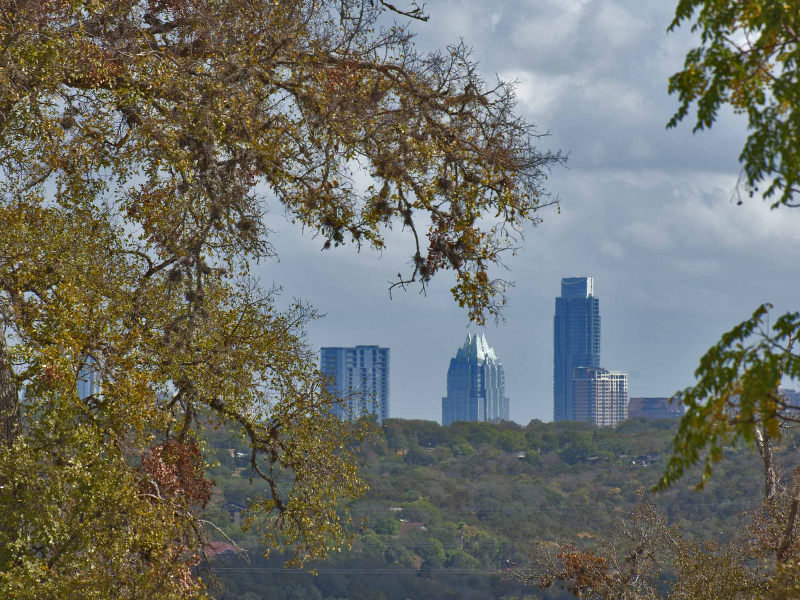

Slide 47
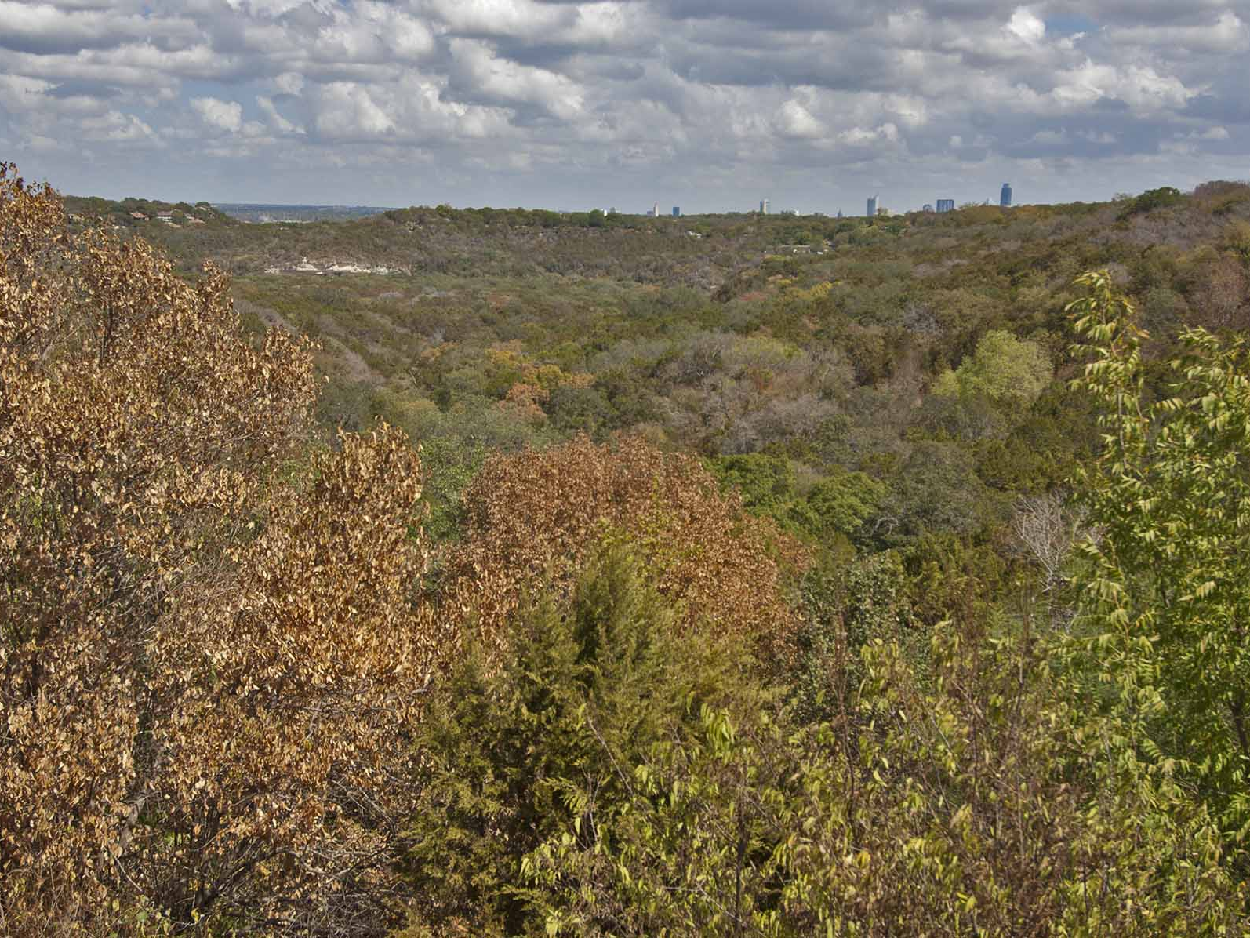

Slide 48
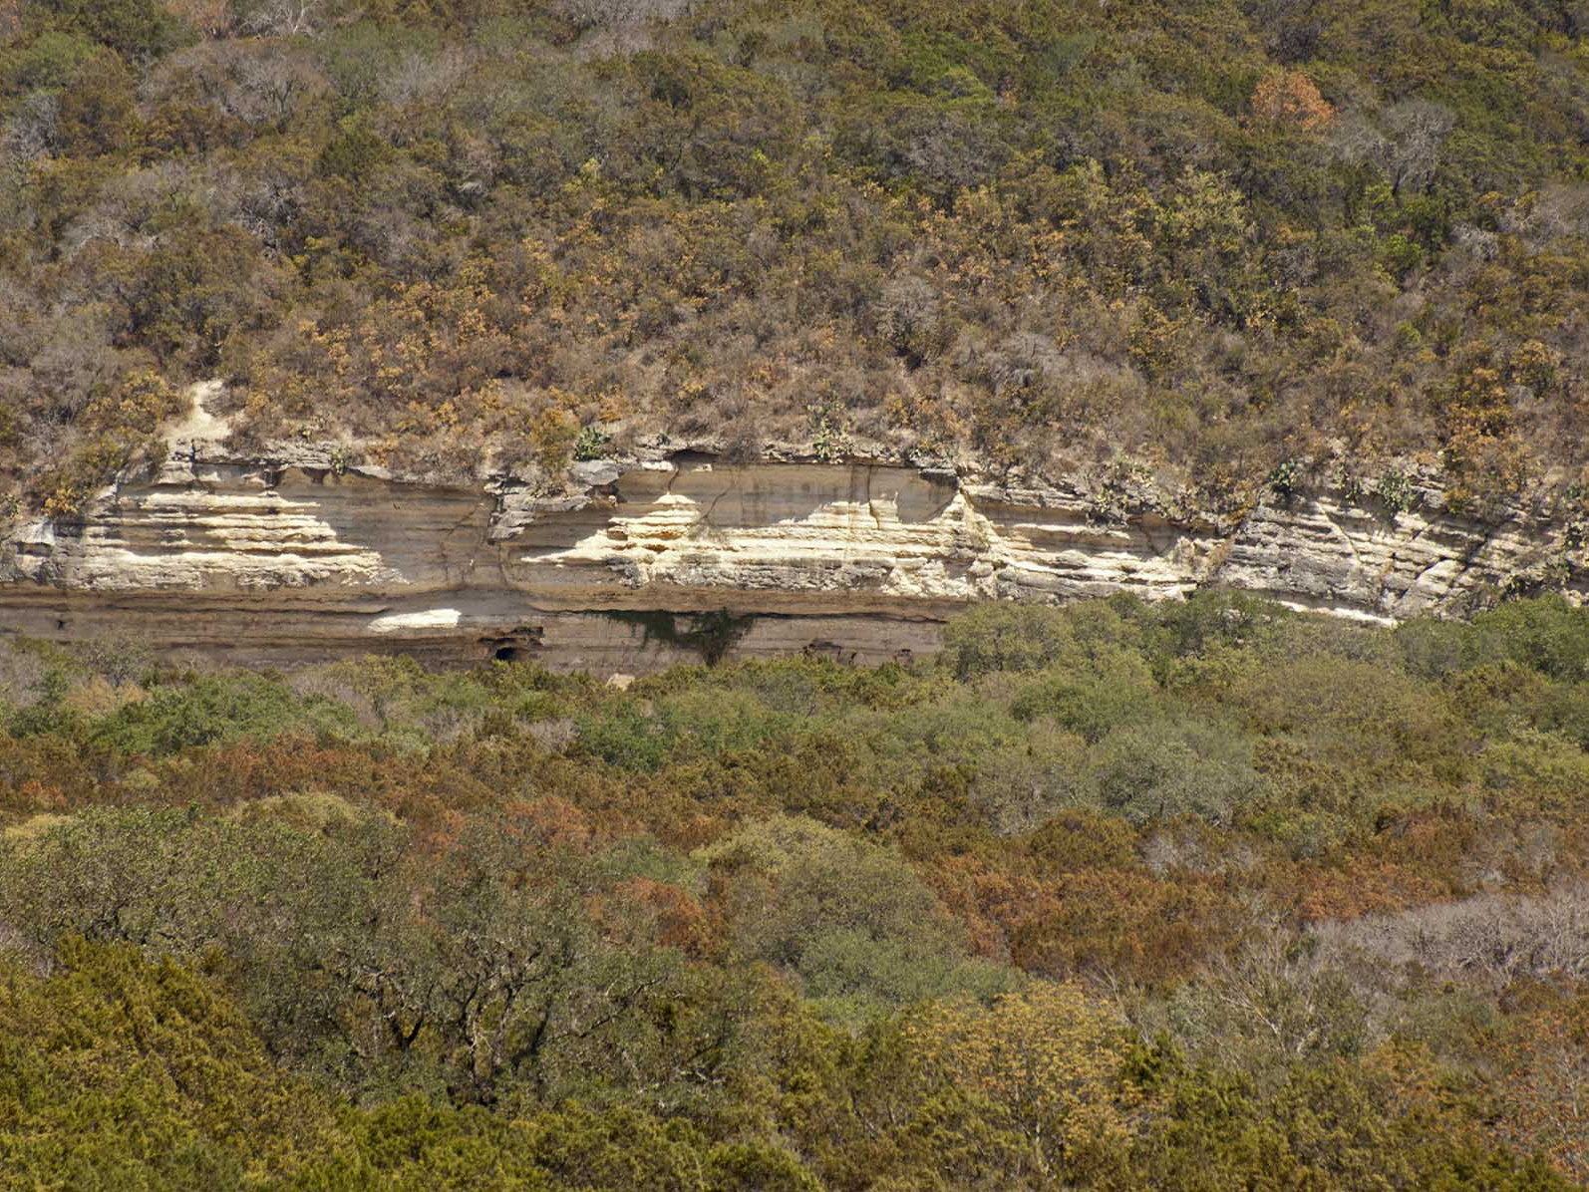

Slide 49
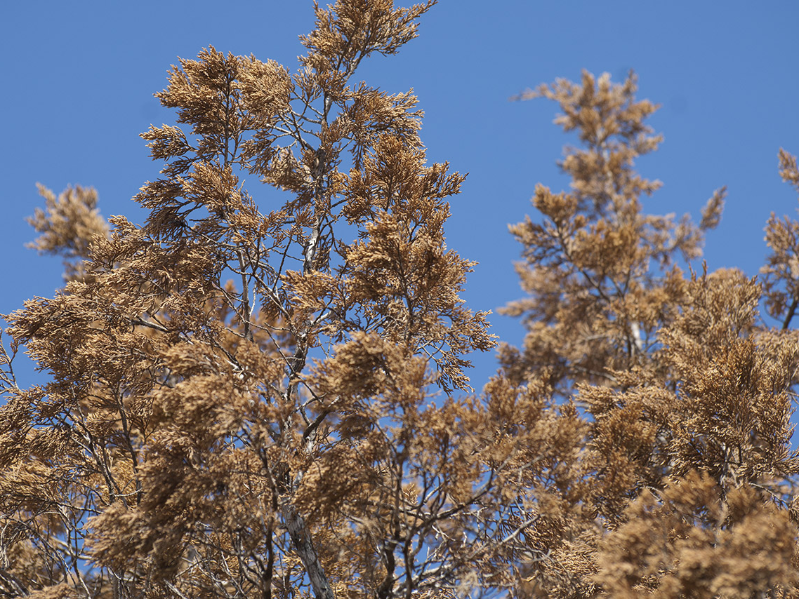

Slide 50
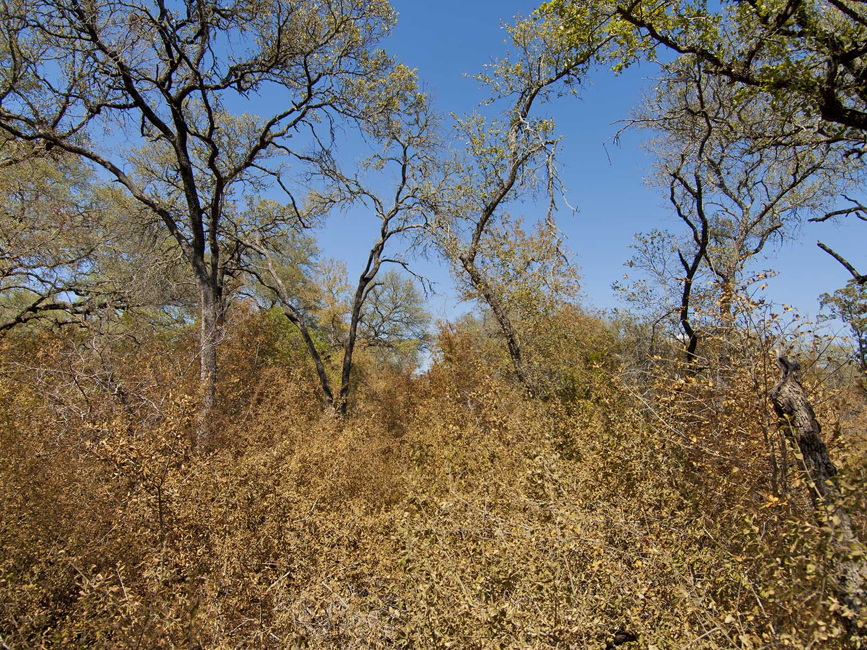

Slide 51
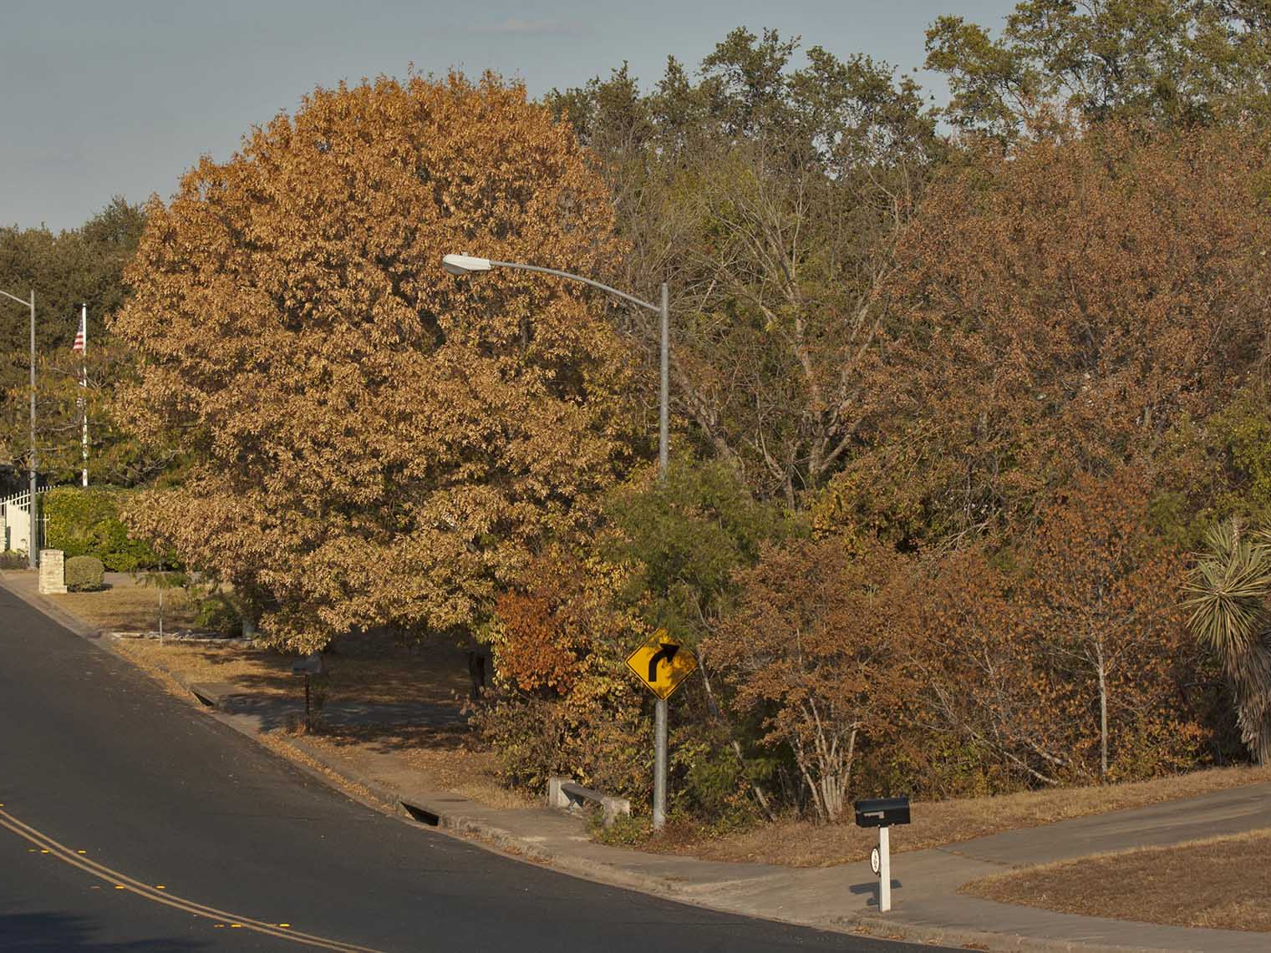

Slide 52
The Oak Hill Firestorm
April 17, 2011

Slide 53
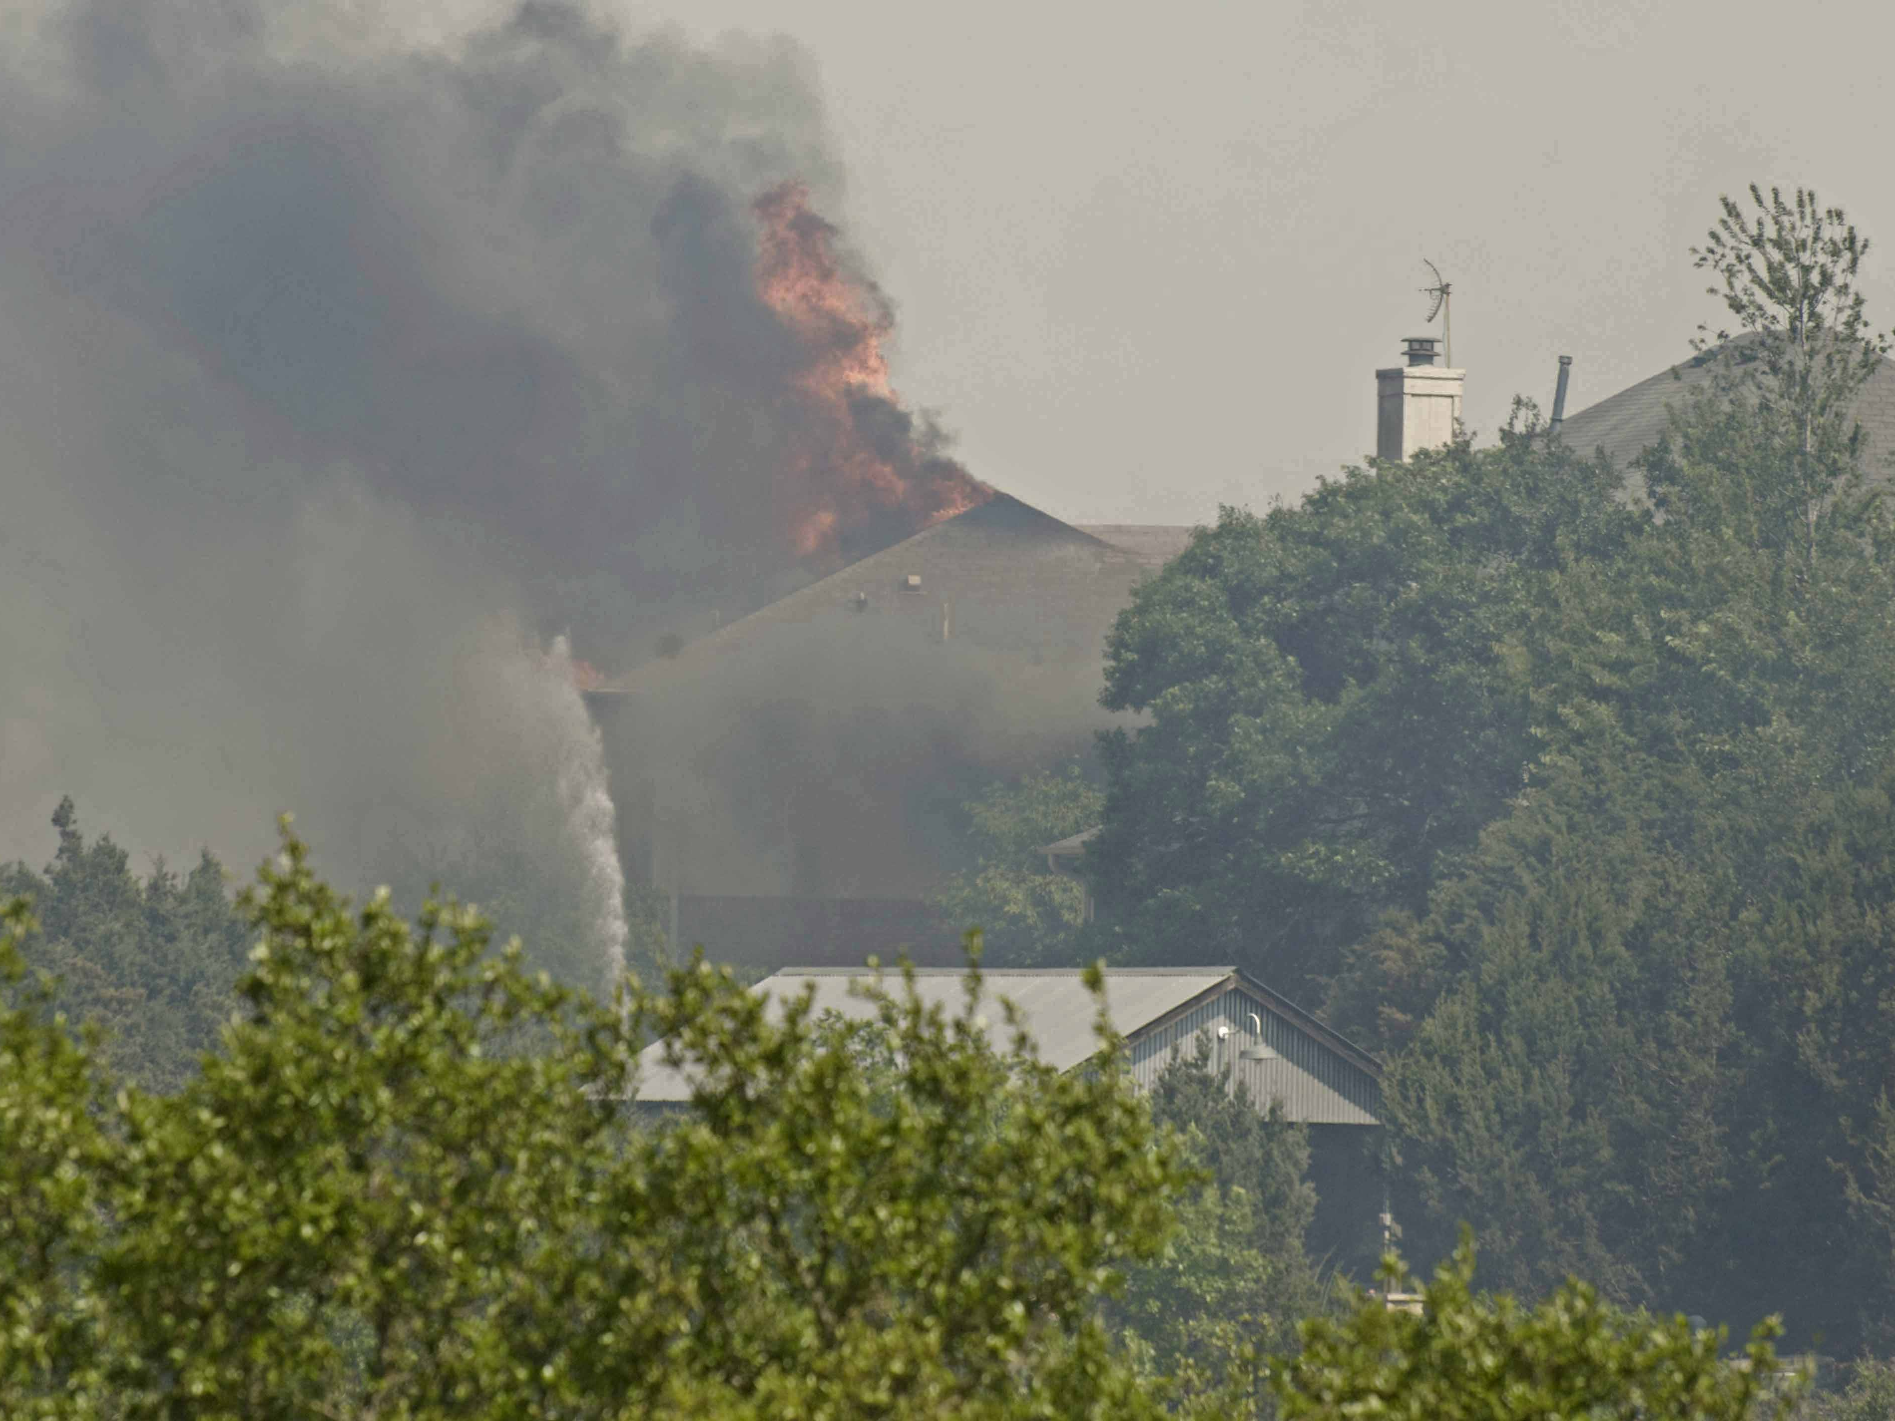

Slide 54
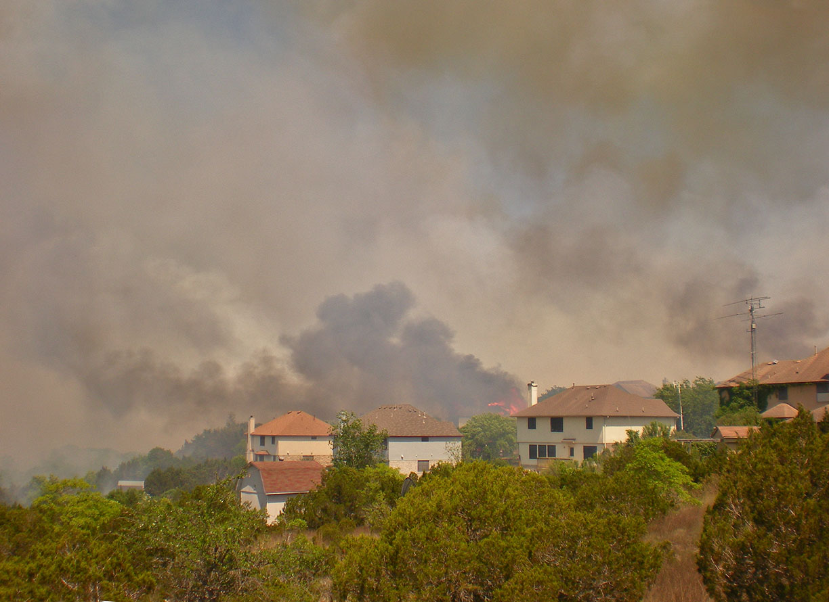
Sally Finan

Slide 55
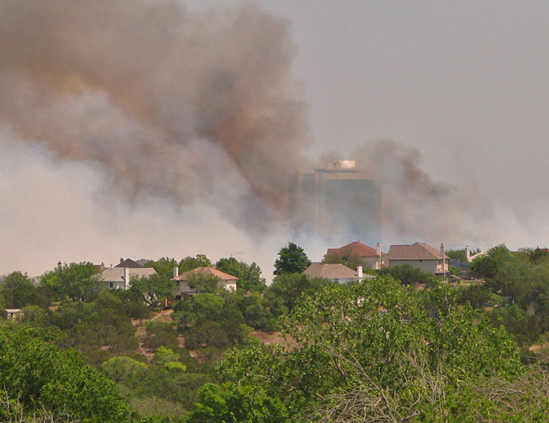
Terry Barhorst

Slide 56
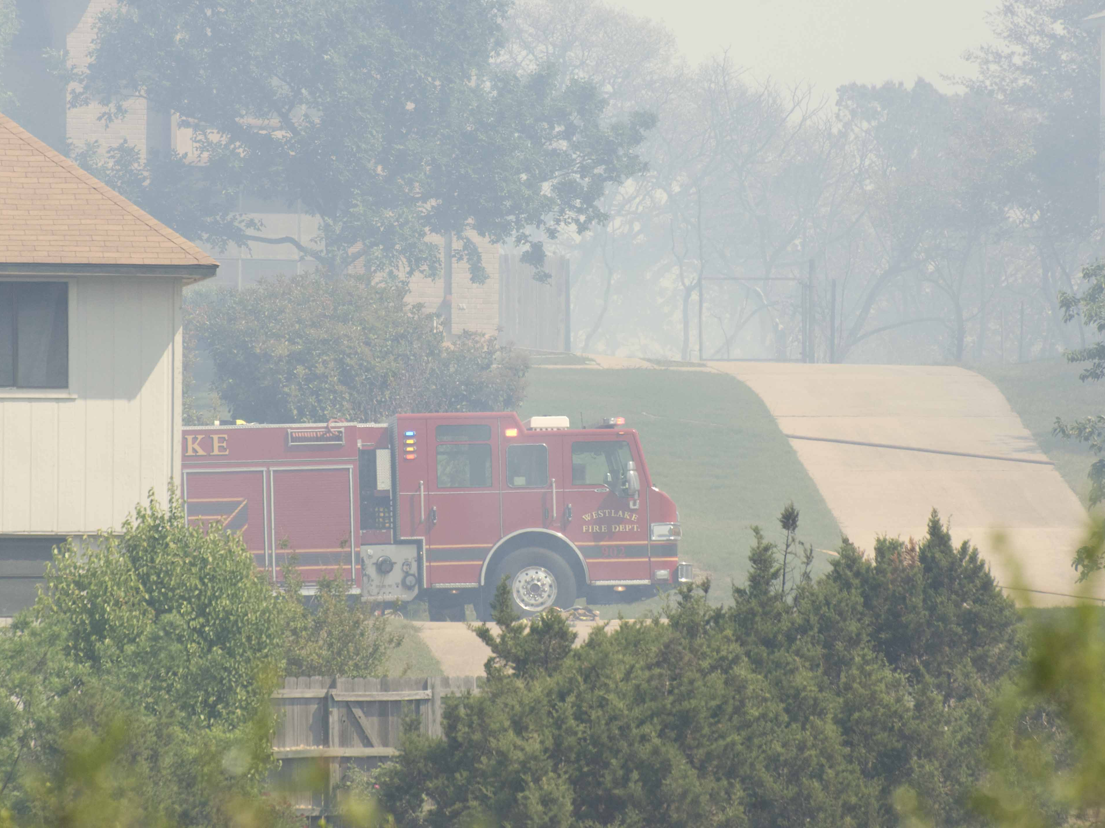

Slide 57
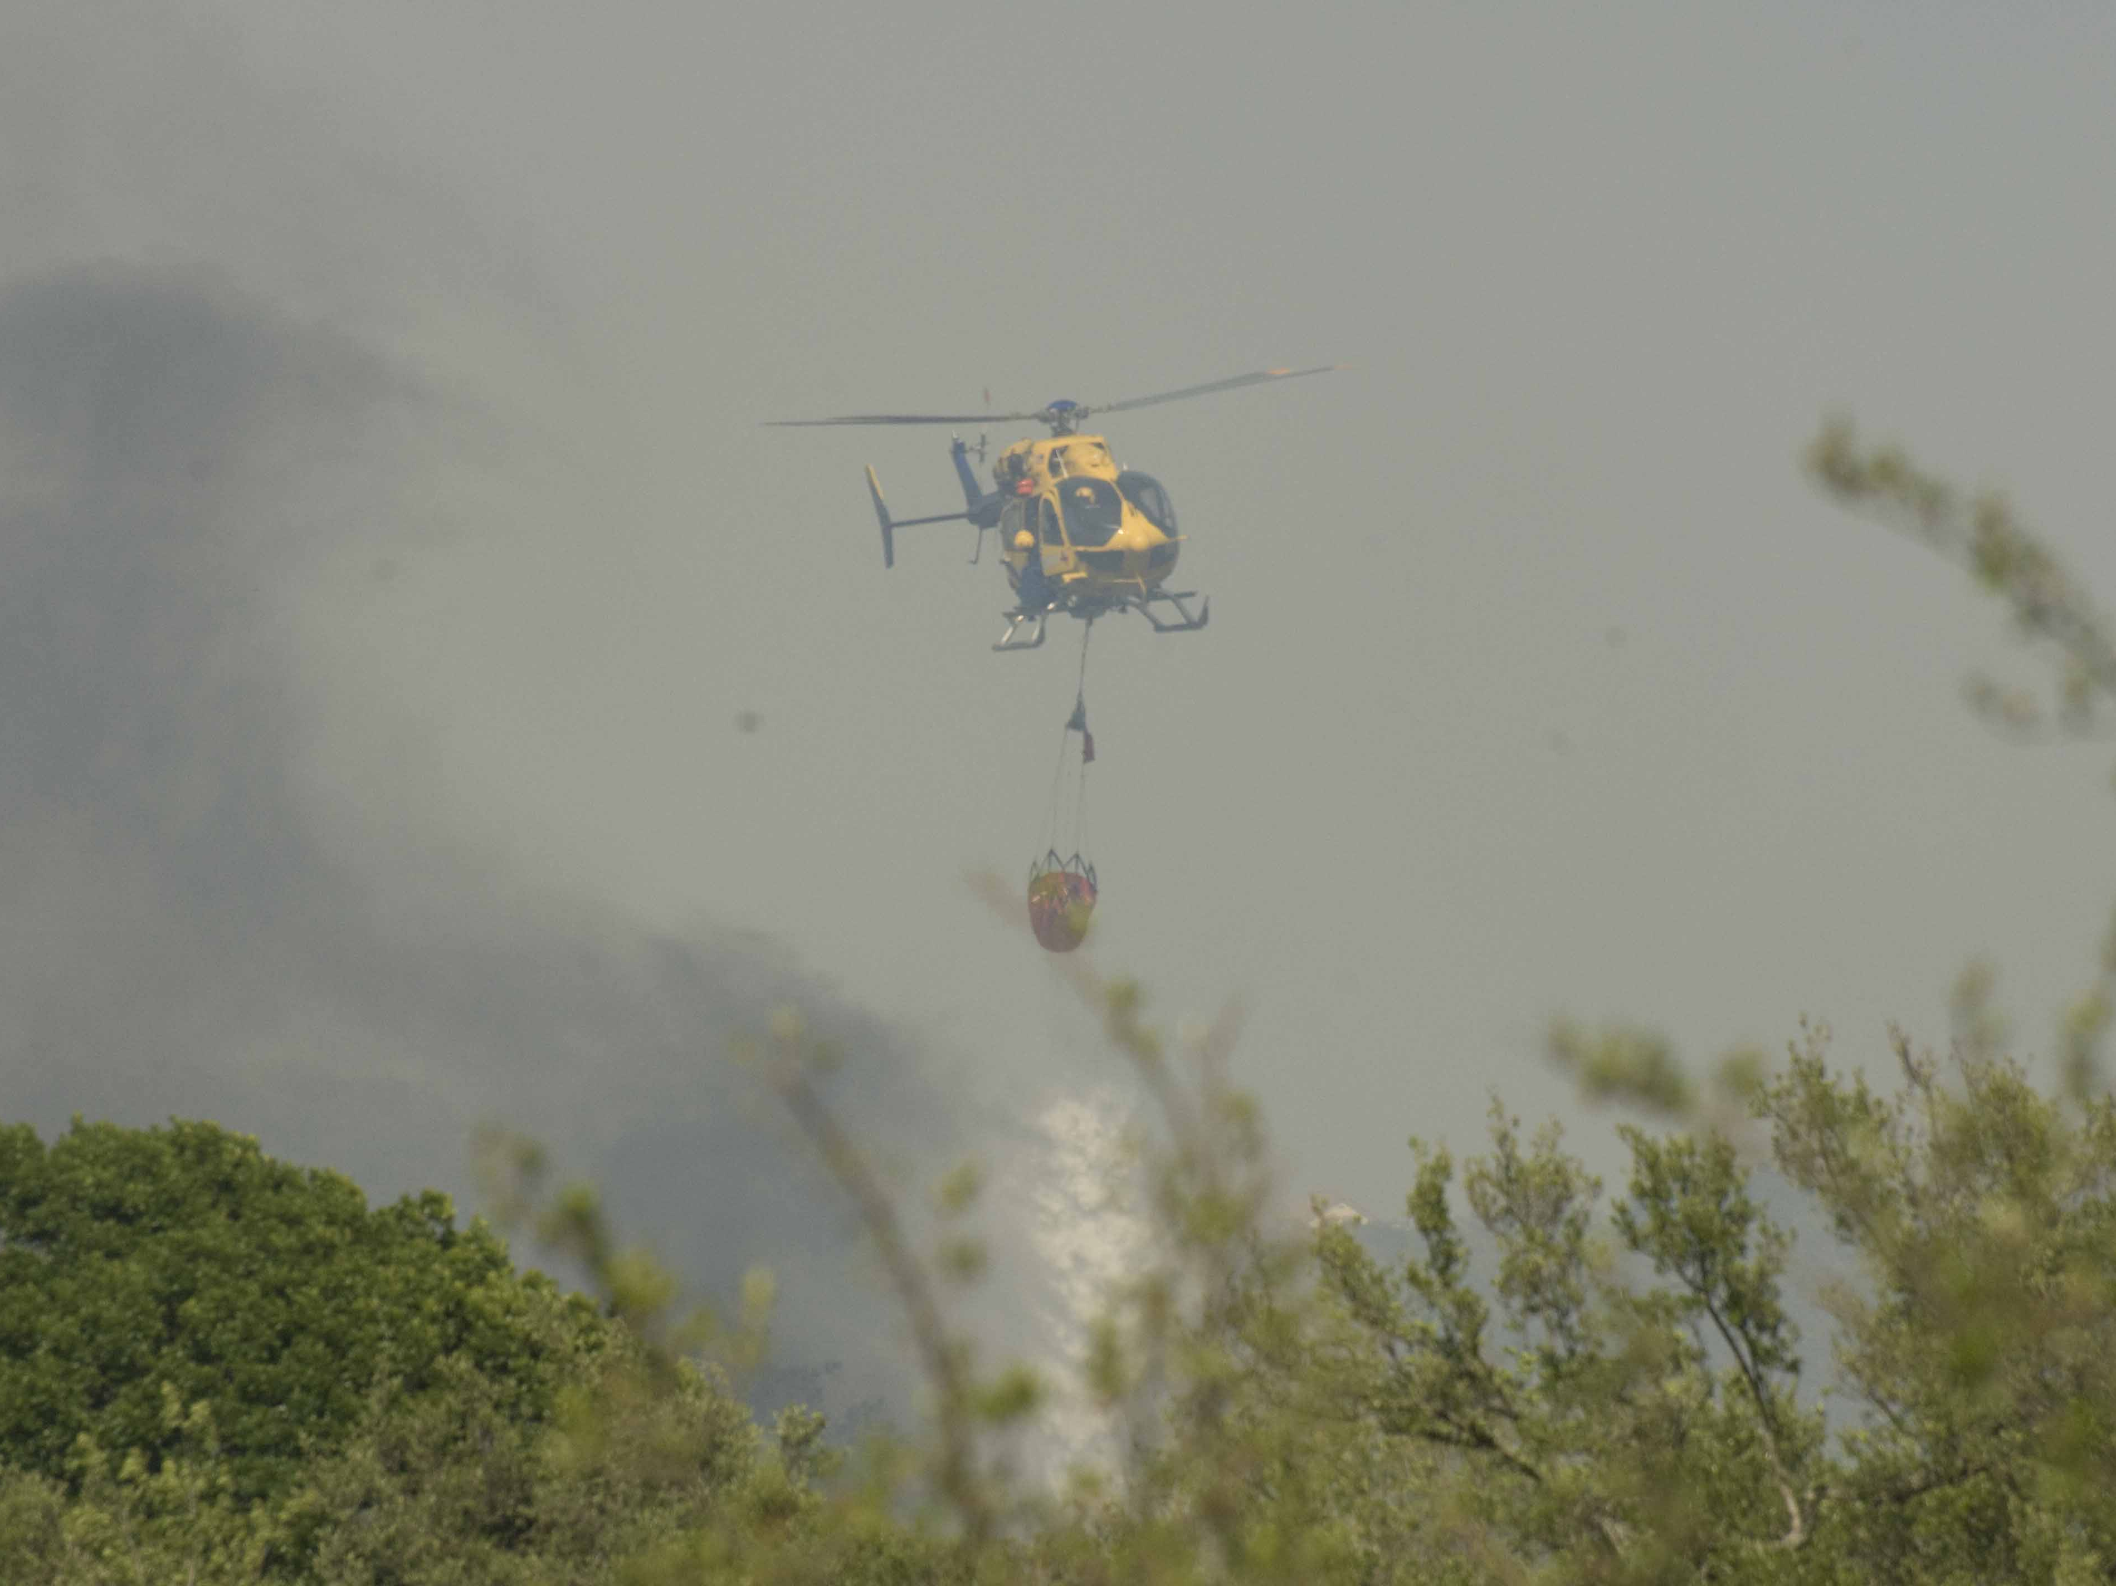

Slide 58
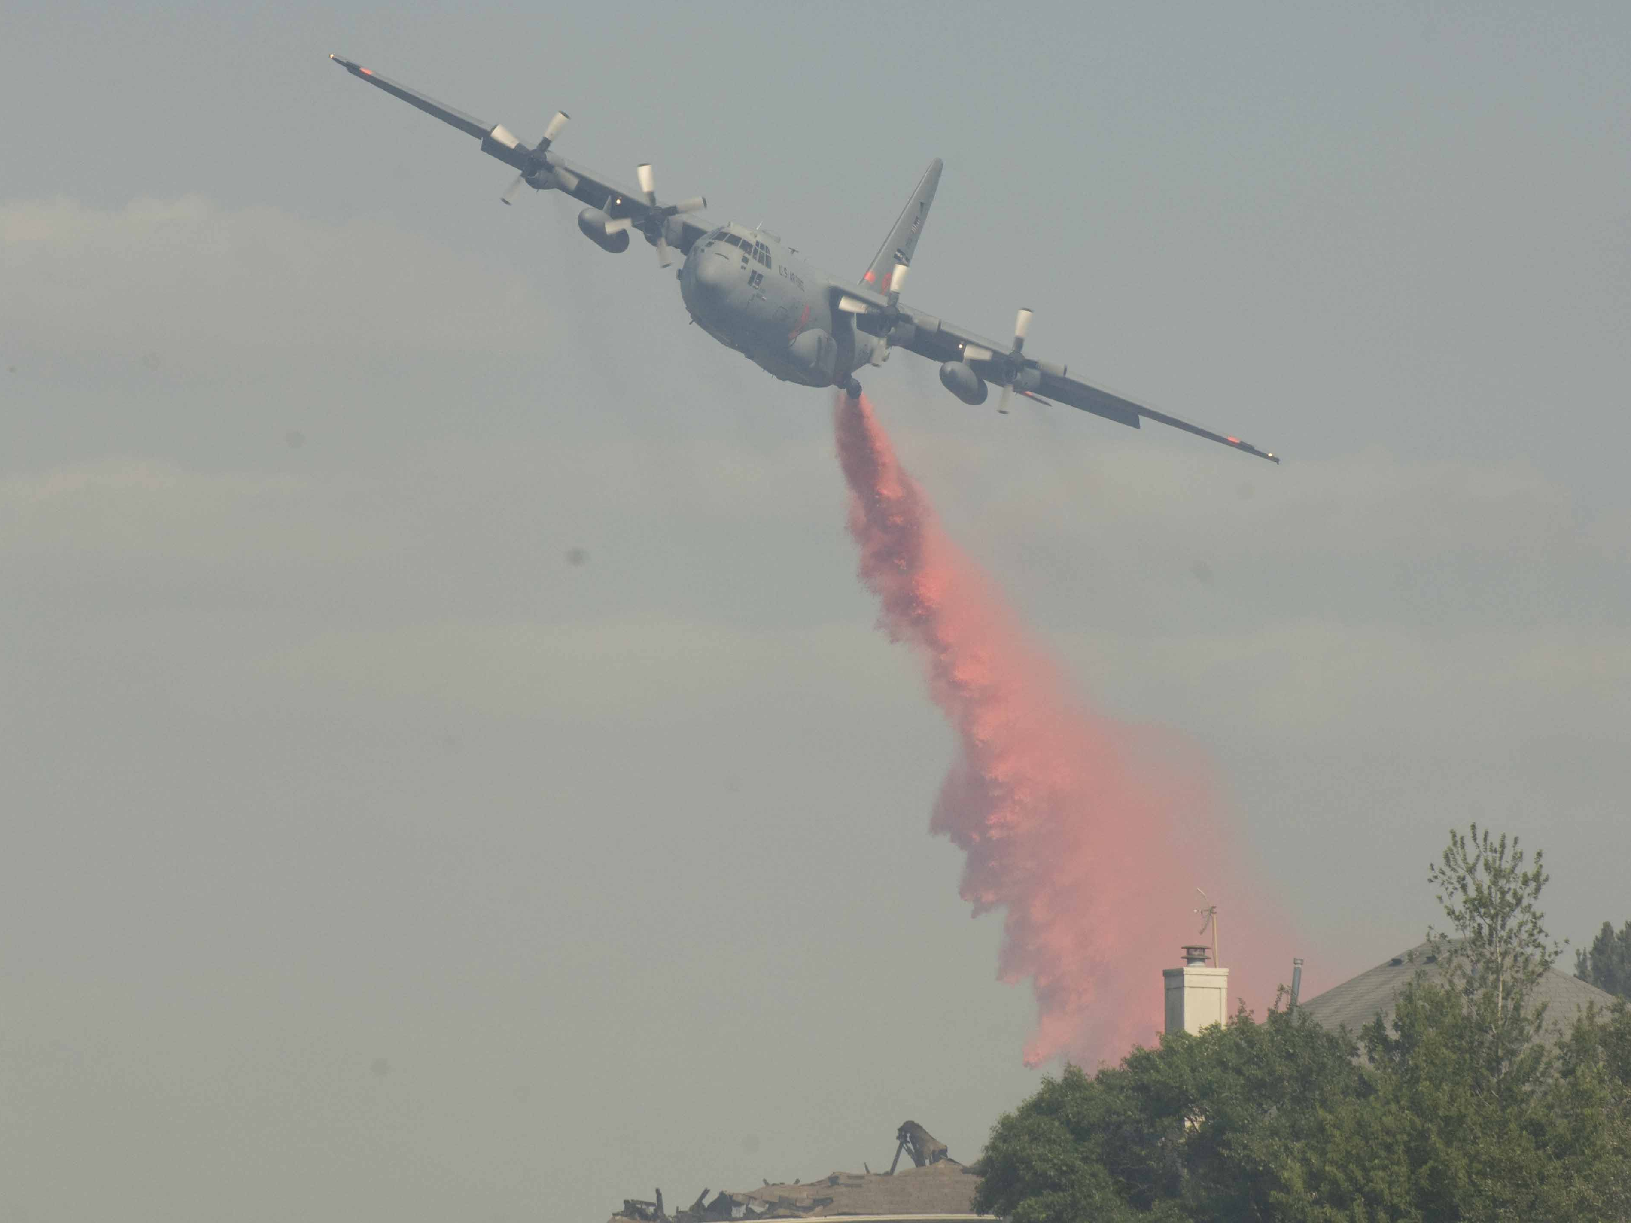

Slide 59
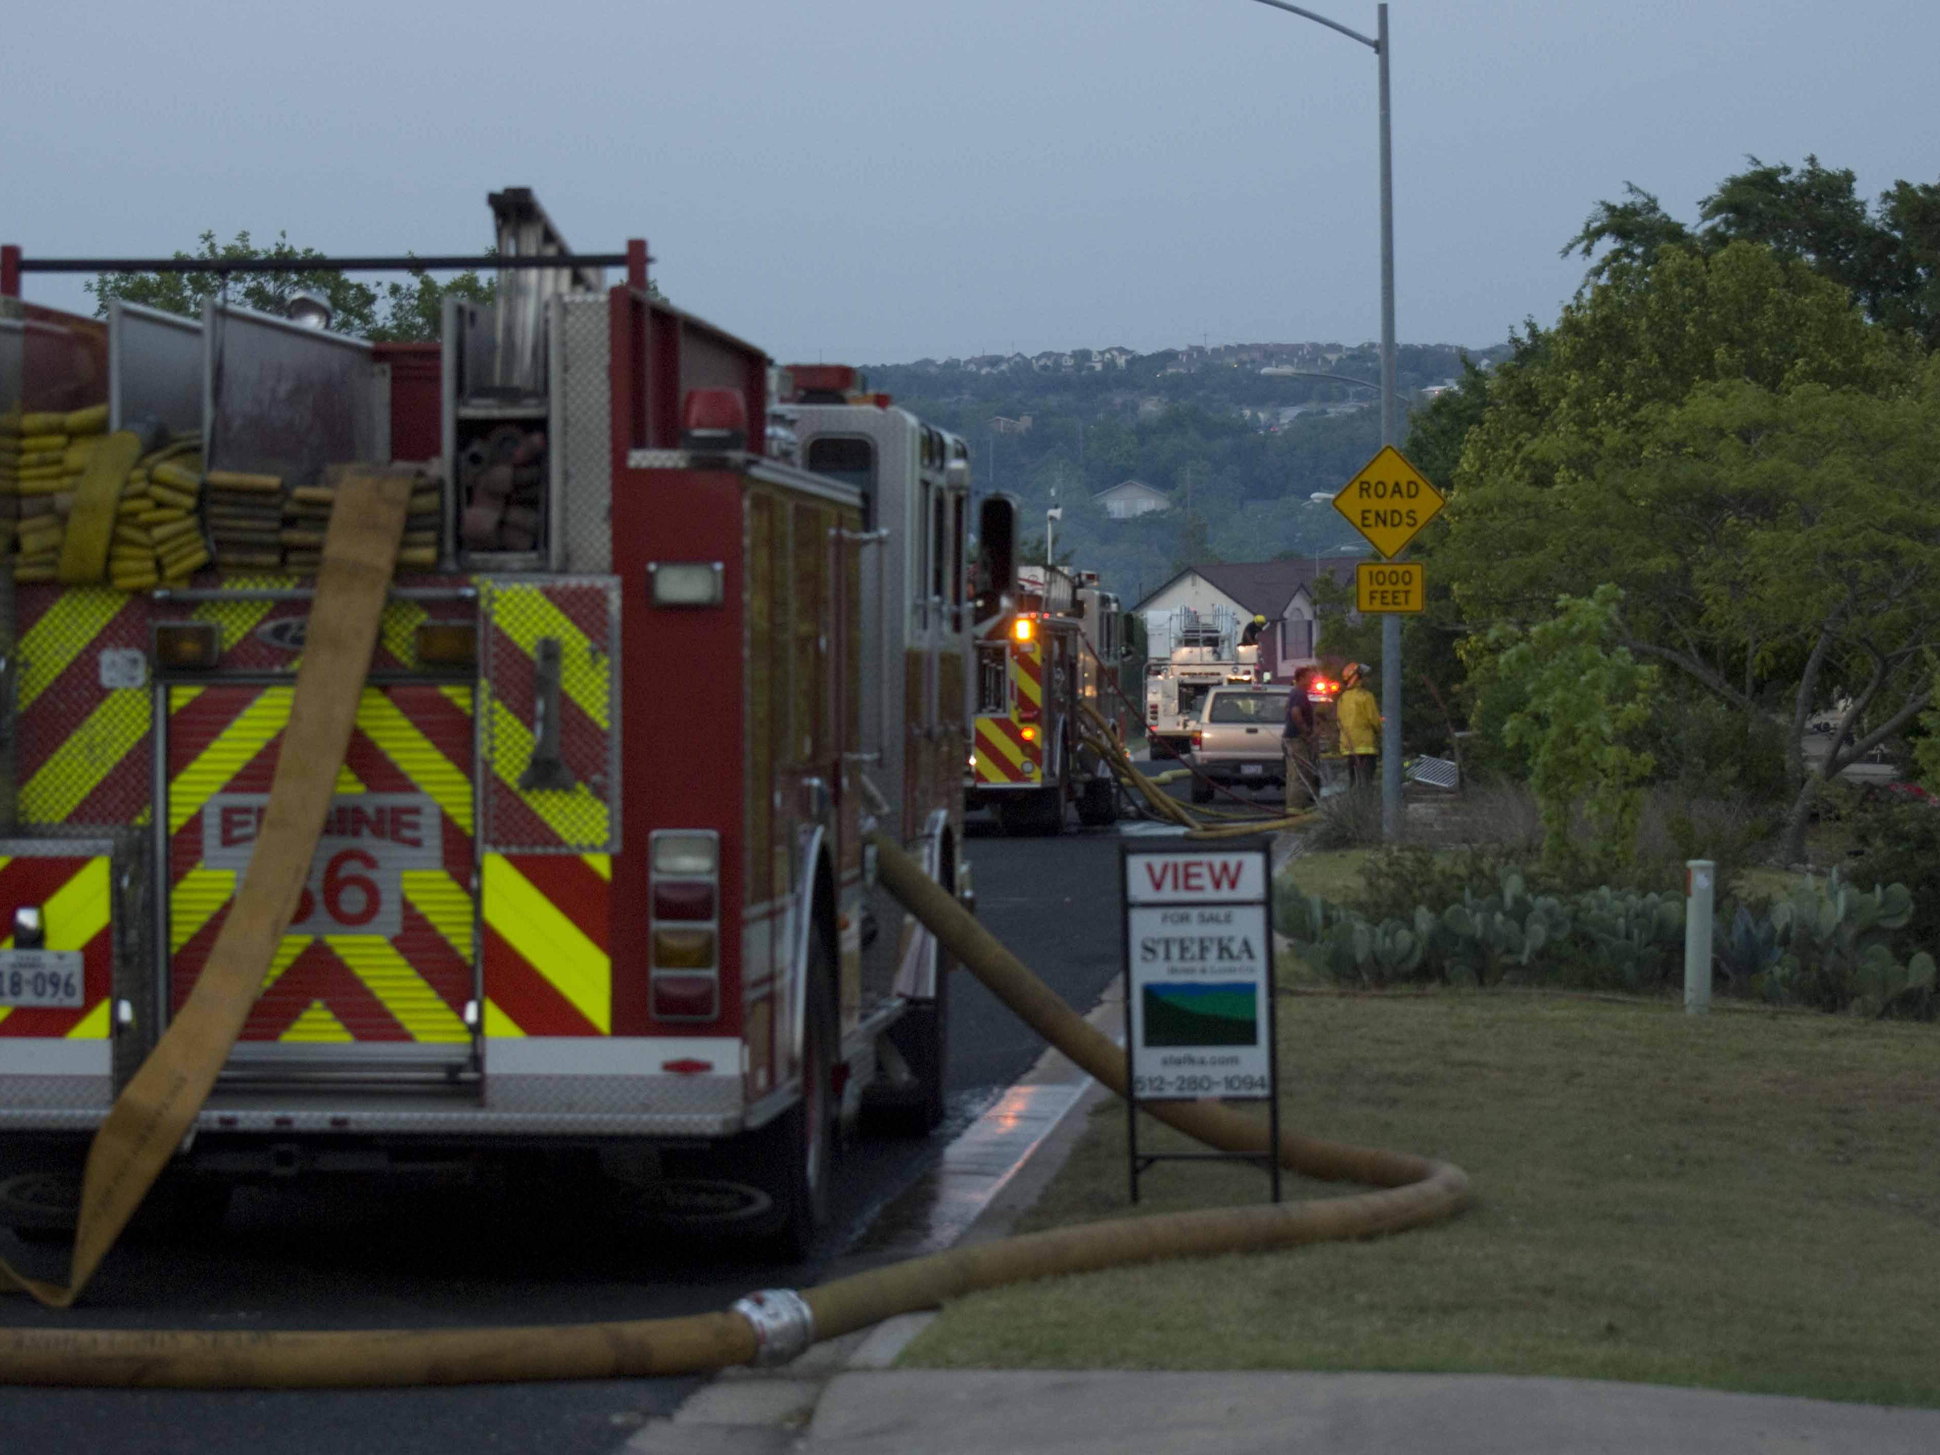

Slide 60
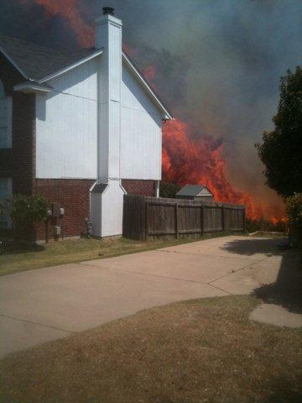
Austin
American
Statesman

Slide 61
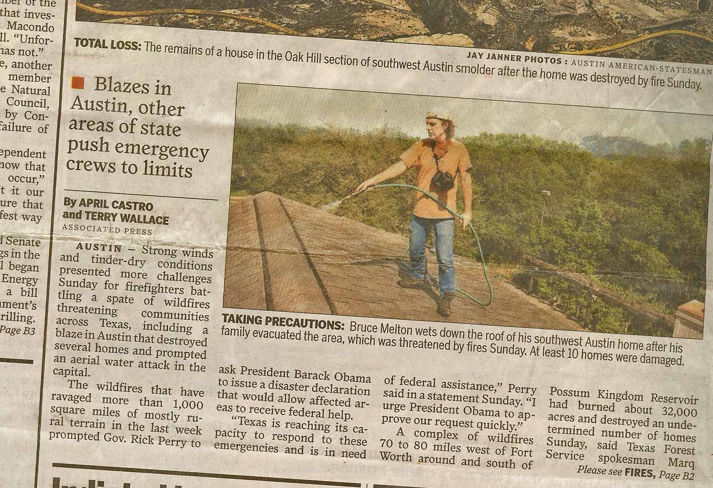
Houston Chronicle

Slide 62
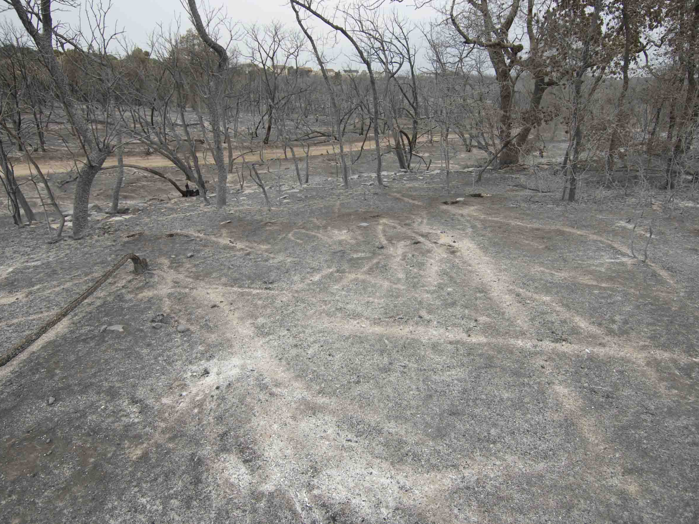

Slide 63
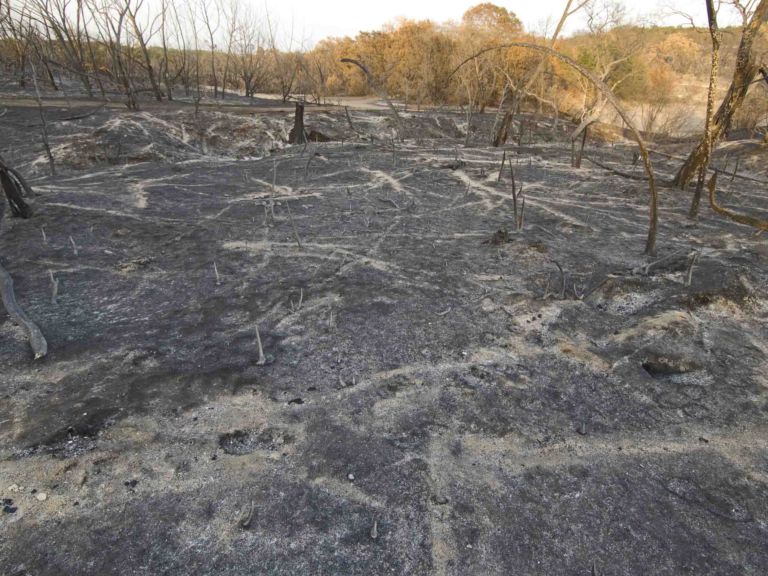

Slide 64
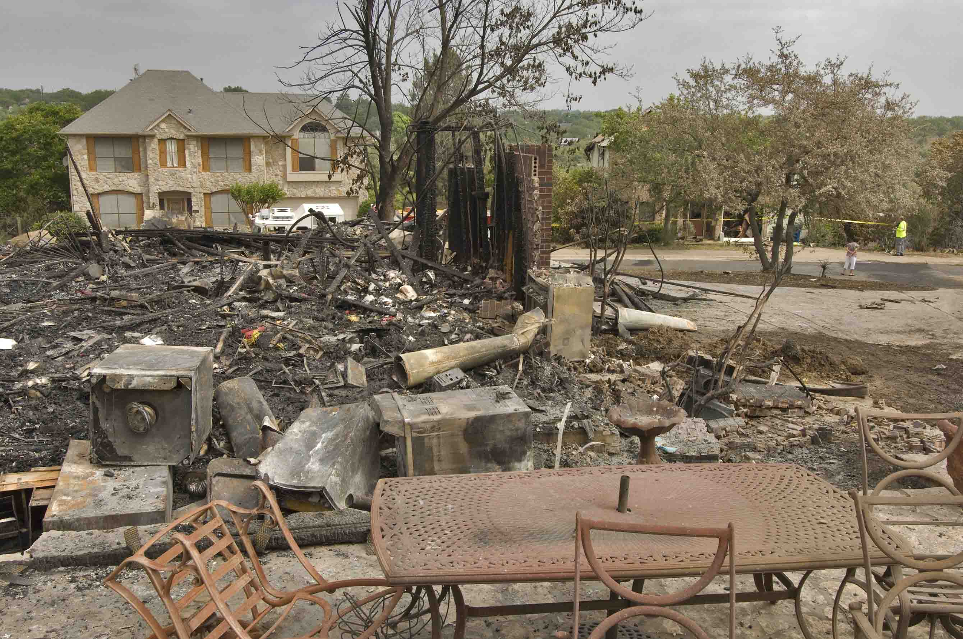

Slide 65


Slide 66


Slide 67


Slide 68

Austin Mabry Average August Temp 1854 to 1998

Slide 69

Austin Mabry Average August Temp 1854 to 2011

Slide 70


Austin Mabry Average August Temps Compare
What happened at the beginning of the 21st century?

Slide 71



Slide 72


Slide 73


Slide 74


Slide 75


Slide 76


Slide 77


Slide 78


Slide 79


Slide 80


Slide 81


Slide 82


Slide 83


Slide 84


Slide 85


Slide 86


Slide 87


Slide 88


Slide 89


Slide 90


Slide 91


Slide 92


Slide 93


Slide 94


Slide 95


Slide 96


Slide 97

It can get a lot worse

Slide 98


Slide 99


Slide 100
What can we do?
Everything we already know to do.
Tell our leaders.
Incentives now, both positive and negative, will allow for the transition to the next age of enlightenment. It happens every time our global society progresses to a new more efficient energy source. It will not cost anything in the long run. It will allow for humankind to become richer than ever before, monetarily and otherwise.
Wood – Peat – Coal – Oil – Solar/Wind/etc.

Slide 101
Remember!
Toilet Pollution!

